Slide 1
“A Ghostly Affair”
Connecticut State Grange
Virtual Social Hour

Slide 2
What is Halloween?
Halloween is a holiday celebrated each year on October 31,
and Halloween 2021 will occur on Sunday, October 31.
The tradition originated with the ancient Celtic festival of Samhain,
when people would light bonfires and wear costumes to ward
off ghosts. In the eighth century, Pope Gregory III designated
November 1 as a time to honor all saints.
Soon, All Saints Day incorporated some of the traditions
of Samhain. The evening before was known as All Hallows Eve,
and later Halloween. Over time, Halloween evolved into a day
of activities like trick-or-treating, carving
jack-o-lanterns, festive gatherings,
donning costumes and eating treats.

Slide 3
Monster Mash
"Monster Mash" is a 1962 novelty song by Bobby "Boris" Pickett.
The song was released as a single on Gary S. Paxton’s
Garpax Records label in August 1962 along with a full-length LP
called The Original Monster Mash, which contained
several other monster-themed tunes. The "Monster Mash" single
was number one on the Billboard Hot 100 chart
on October 20–27 of that year, just before Halloween.
It has been a perennial Halloween favorite ever since.

Slide 4


Slide 5
Most Popular Costumes 2020
1. Witch
2. Vampire
3. Cat
4. Batman
5. Ghost

Slide 6
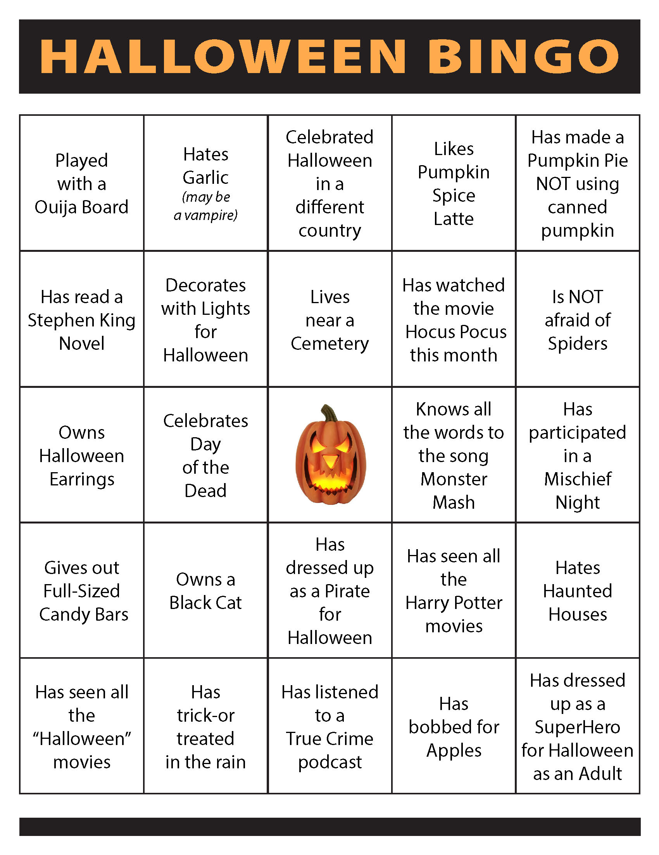

Slide 7
Halloween
Fun Facts

Slide 8
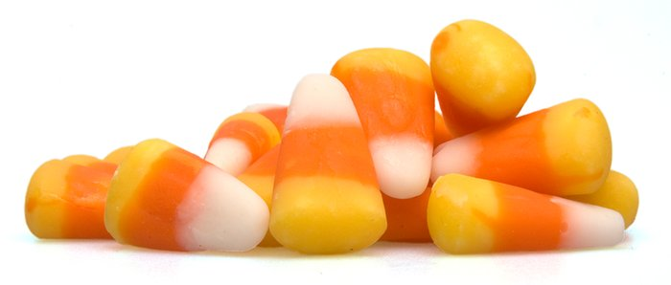
Candy corn was originally called Chicken Feed
Created in the 1880s by George Renninger,
candy corn was sold to the masses by
Goelitz Confectionery Company (now Jelly Belly Co.)
at the turn of the century.
Because corn is what was used to feed chickens,
the creation was called "Chicken Feed"
and the box was marked with a colorful rooster.

Slide 9
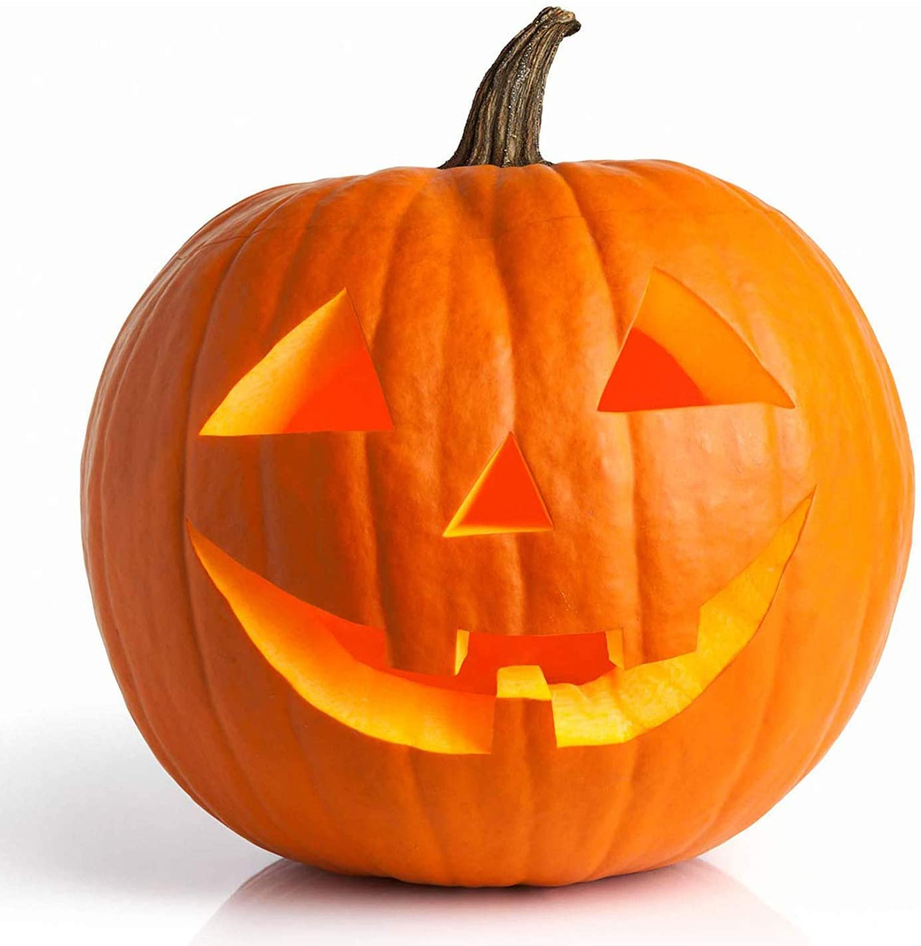
The most lit jack o'lanterns
on display is 30,581
According to Guinness World Records,
the highest number of lit jack o'lanterns
on display is 30,581 by the
City of Keene, New Hampshire in 2013.
Keene, represented by Let it Shine,
has broken the record 8 times over
since the original attempt.
That's a whole lot of pumpkins!

Slide 10
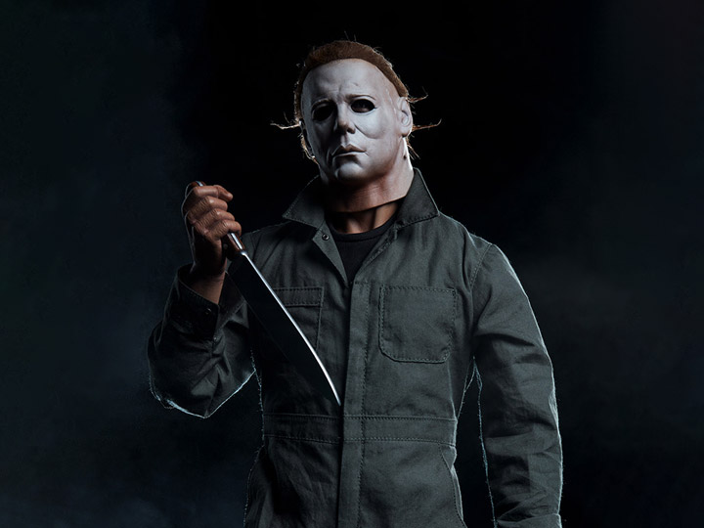
Michael Myers' mask is actually
a William Shatner mask
The classic 1978 horror film "Halloween" can be
easily recognized in just one image: the psychotic Michael Myers
in his iconic pale-faced mask. The movie was actually filmed
on such a tight budget that the crew used the cheapest
mask they could find: a $2 Star Trek Captain James Kirk mask.
They spray painted it white and reshaped the eye holes.

Slide 11
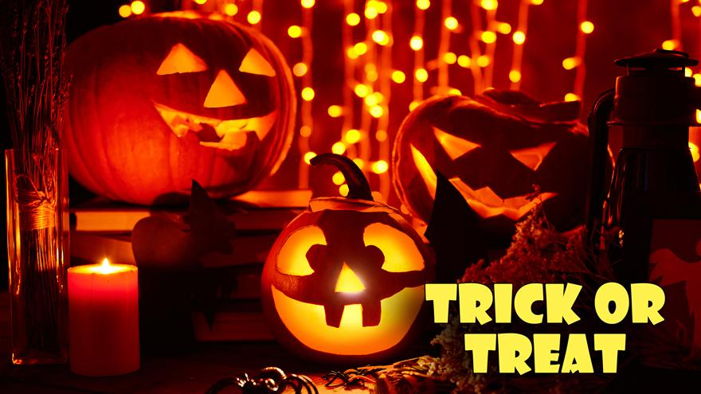
Trick-or-treating was inspired by
a tradition called "mumming."
In the middle ages, people began practicing a tradition
known as mumming, in which they dressed up as
ghosts and demons, and went door-to-door performing
songs and scenes from plays in exchange
for food and drink. This custom is believed to be
an antecedent of trick-or-treating.

Slide 12
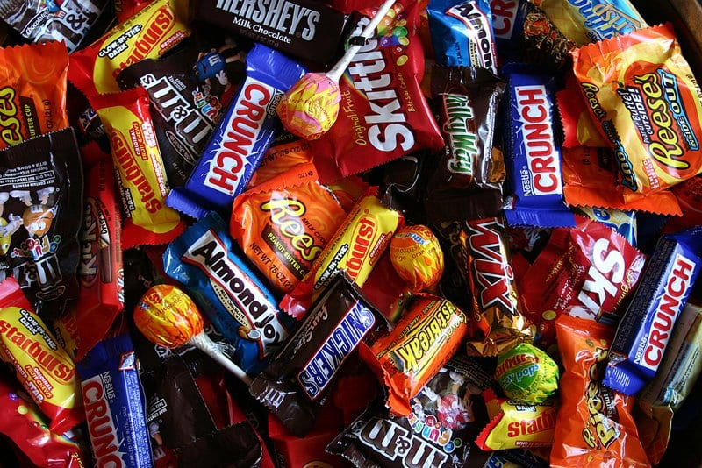
Candy wasn't given out to
trick-or-treaters until the Fifties
Trick-or-treaters didn't receive candy at all,
but rather pieces of cake, fruit, nuts, coins, and little toys,
according to the History Channel. It wasn't until the 1950s,
when candy makers began to promote their goods
for Halloween, that candy became a staple on the trick-or-treating circuit.
These days, one quarter of all the candy sold in the U.S.
each year is purchased for Halloween.

Slide 13
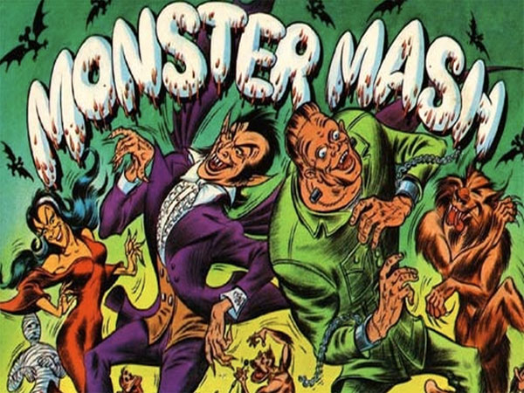
The song "Monster Mash”
was briefly banned in the U.K.
The BBC banned the hit 1962 song from airplay
that year because they thought it was “too morbid.”
The perennial Halloween favorite didn't become
a “graveyard smash” in the U.K. until it was re-released there in 1973.

Slide 14
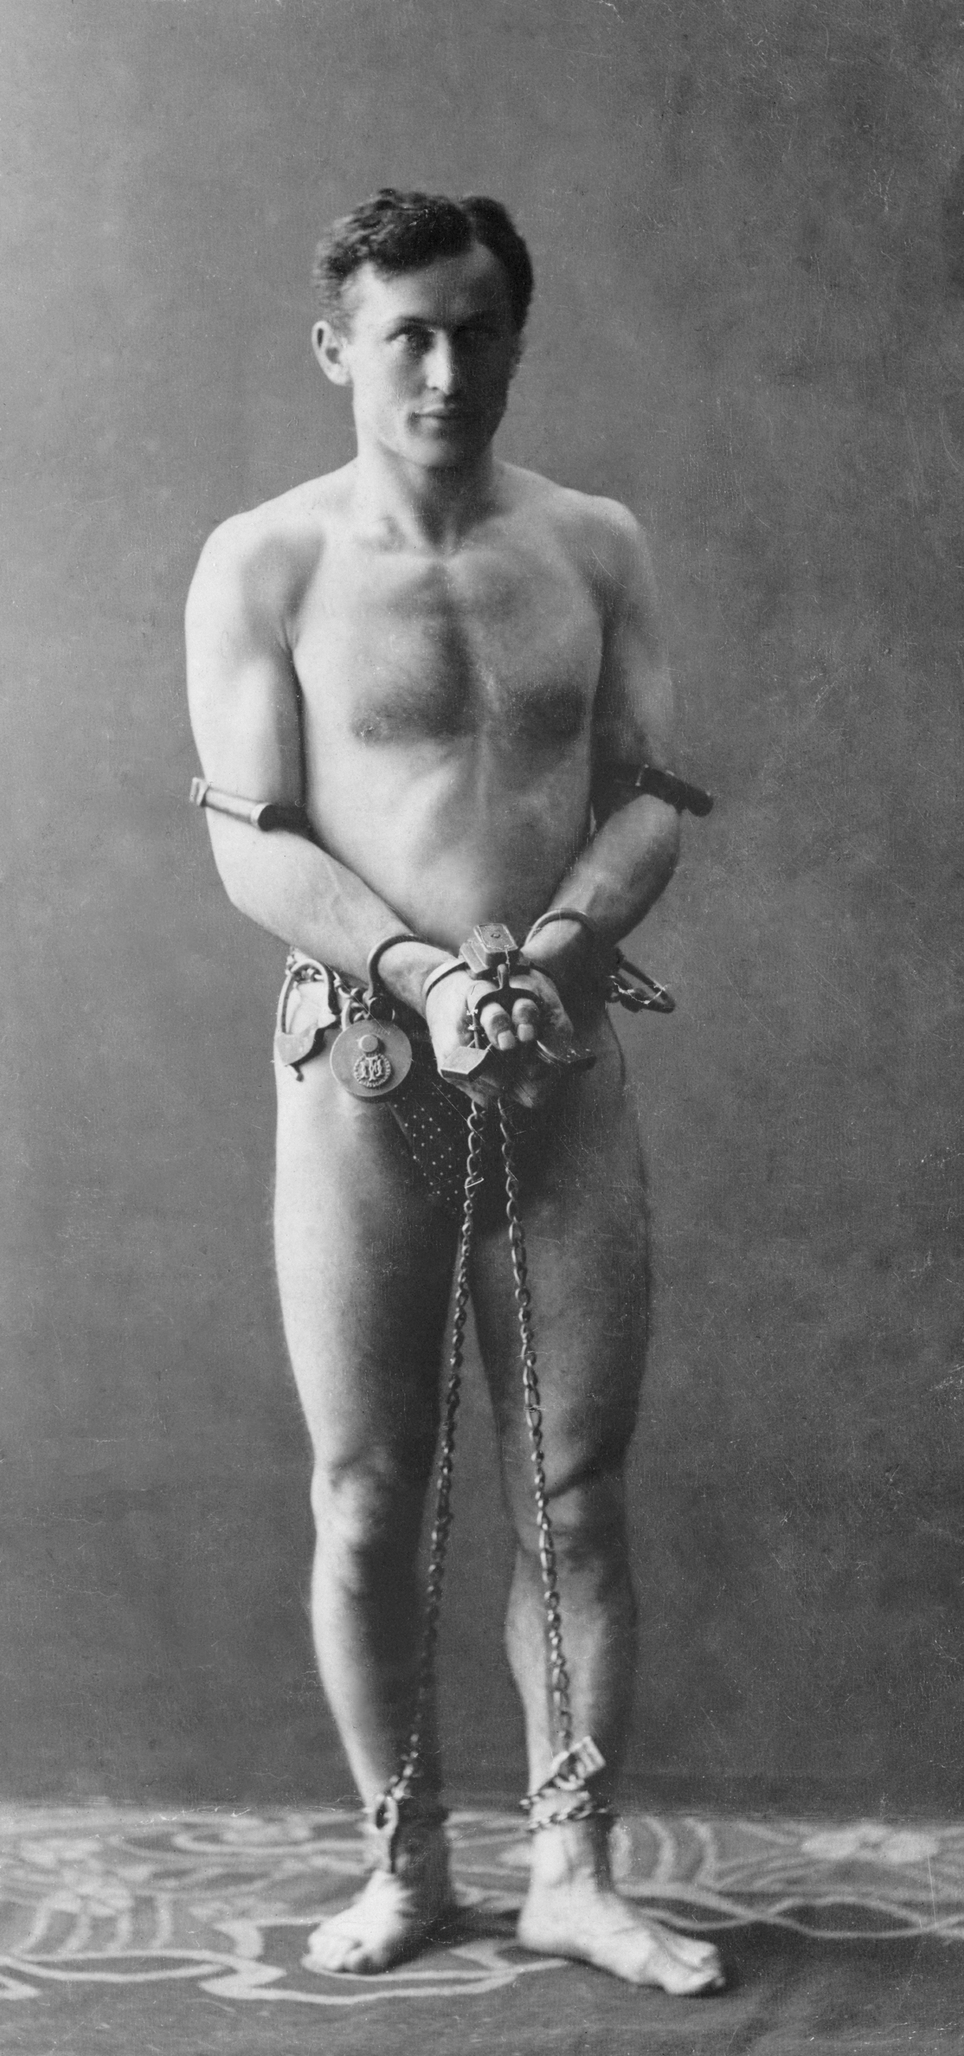
Harry Houdini died
on Halloween in 1926
The world famous magician and
illusionist died on October 31 after
his appendix burst, according to
Newsweek. He was rushed to the
hospital after a performance on the
night of October 24, 1926 in Detroit.
He died a week later from Peritonitis,
or the inflammation of organs caused
by organ leaking.

Slide 15
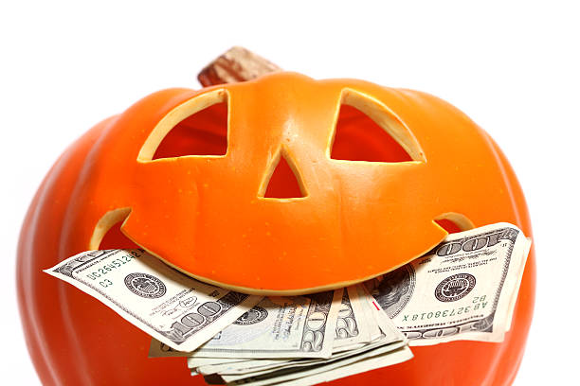
Halloween is the second largest
commercial holiday
It ranks second after only Christmas. Consumers spent
approximately $9 billion on Halloween in 2019,
according to the National Retail Federation.
Spending was down a bit in 2020 because of the
COVID-19 pandemic, but Americans still forked over
$8 billion overall, or an average of $92 per person.

Slide 16
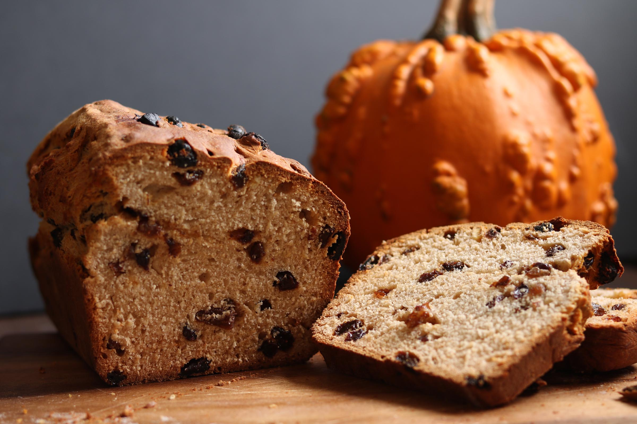
There's a traditional Halloween
bread in Ireland
It's called barmbrack or just "brack."
The sweet loaf typically contains dark and golden raisins,
as well as a small hidden toy or ring.
Similar to the classic king cake at Mardi Gras,
tradition dictates that the person who finds the item
will come into good fortune in the coming year.

Slide 17
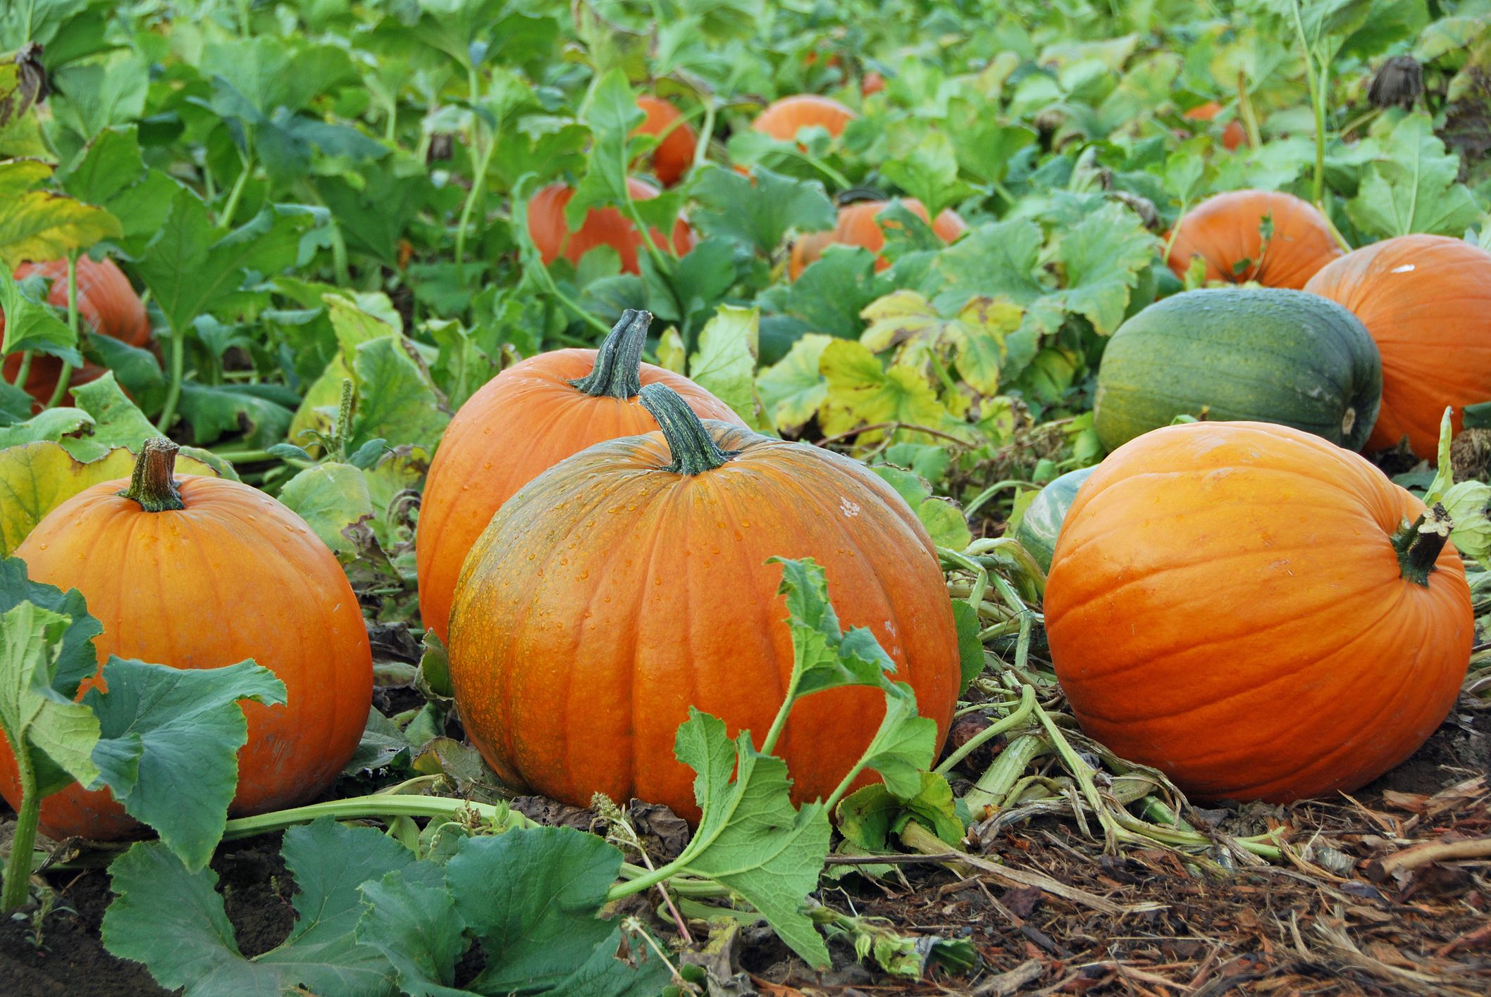
Illinois produces up to five times more pumpkins than any other state.
The Land of Lincoln has more than 15,000 acres
devoted to gourd growing, according to the
United States Department of Agriculture.
Those Illinois farms typically grow more than
500 million pounds of pumpkins annually.

Slide 18
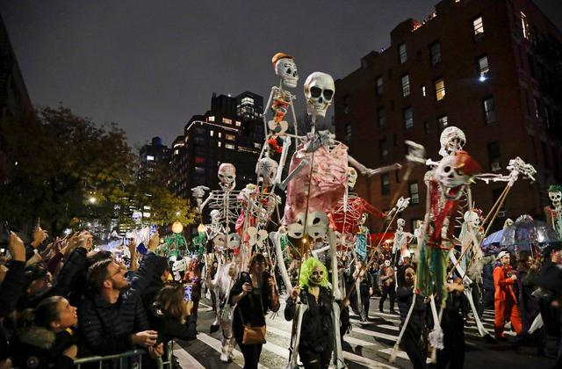
New York City throws the biggest Halloween parade in the U.S.
The event draws more than 2 million spectators and includes
thousands of participants joining in the route along the way.
It all began as the brainchild of Greenwich Village resident and
puppeteer Ralph Lee, who just wanted to throw a whimsical walk
from house to house for his kids and their pals. When a local theatre
got wind of it, they joined in and grew the event. It's gotten bigger,
more creative and more theatrical ever since.

Slide 19
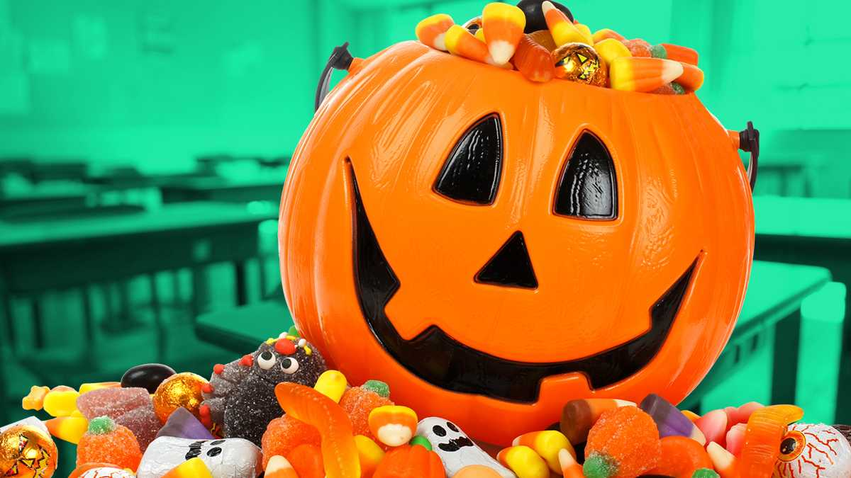
Americans spend nearly
$3 billion each year on candy
2017 holds the record for Halloween spending on
Candy in the US, with $3.1 billion being spent
on the holiday. According to a survey by
the National Retail Federation, 95% of respondents
purchased candy that year.

Slide 20
The 10 most popular Halloween
Candy Varieties
1) Reese's Peanut Butter Cups
2) Skittles
3) M&M's
4) Starburst
5) Hot Tamales
6) Sour Patch Kids
7) Hershey Kisses
8) Snickers
9) Tootsie Pops
10) Candy Corn

Slide 21
You Know You’re
Too Old To Go
Trick-or-Treating When…

Slide 22
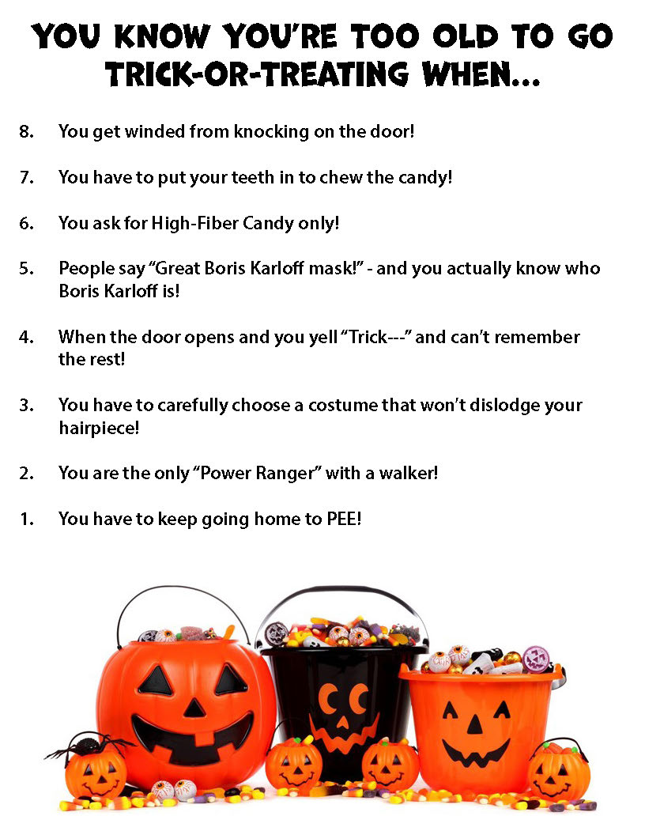

Slide 23
Are You A Zombie?

Slide 24
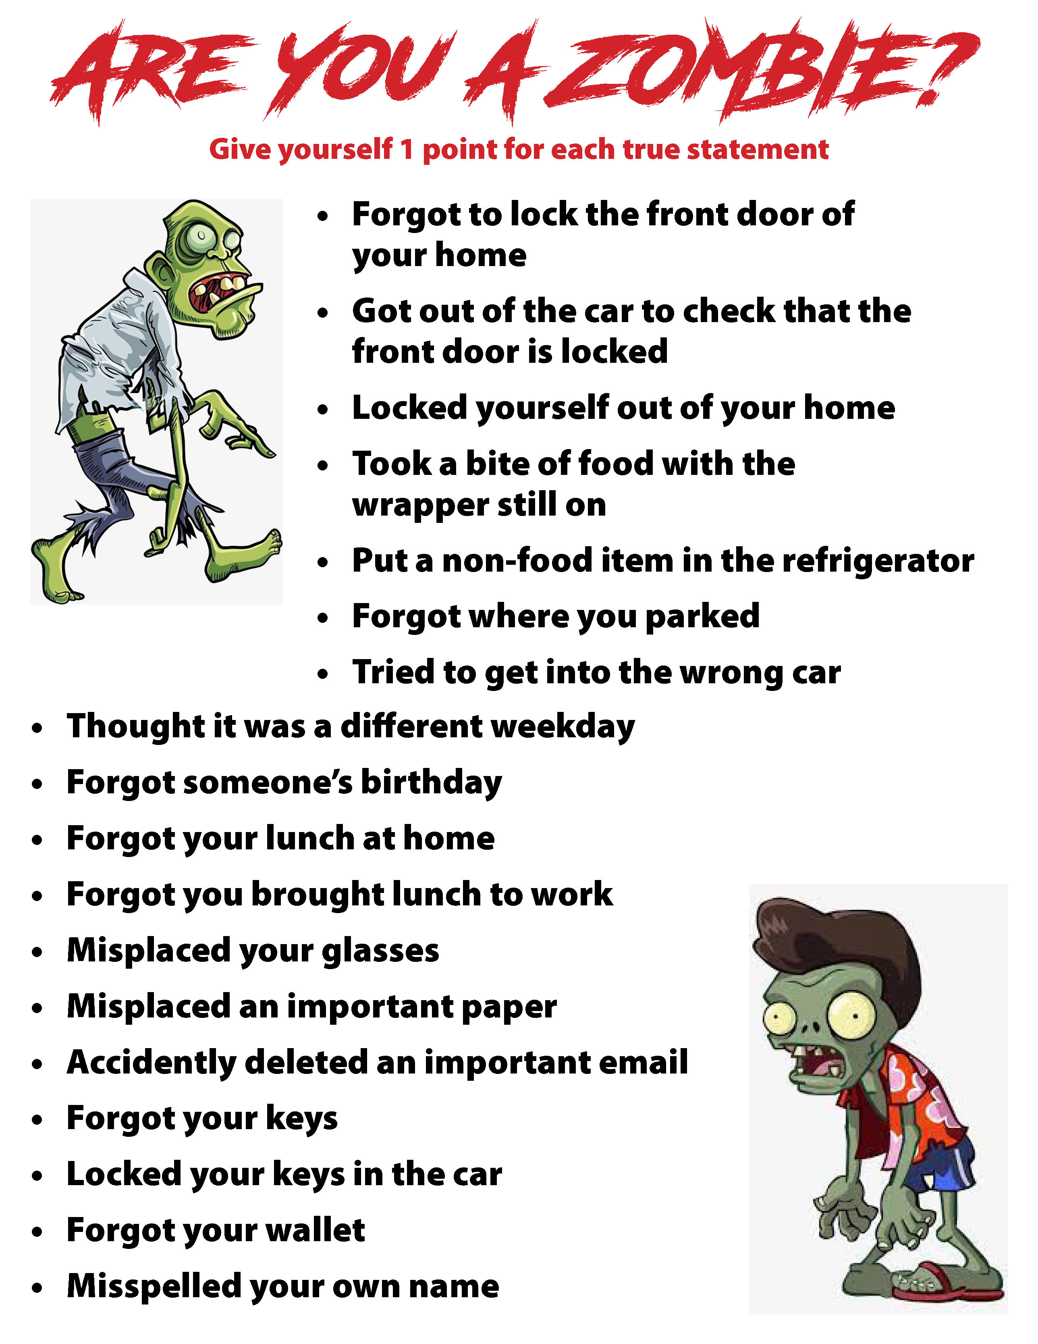

Slide 25
Name That Character

Slide 26
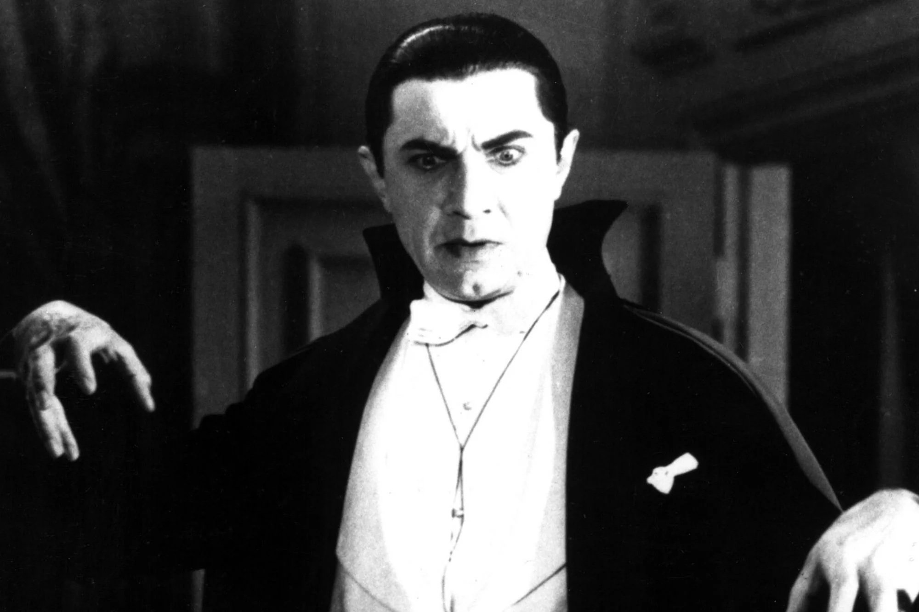
#1

Slide 27
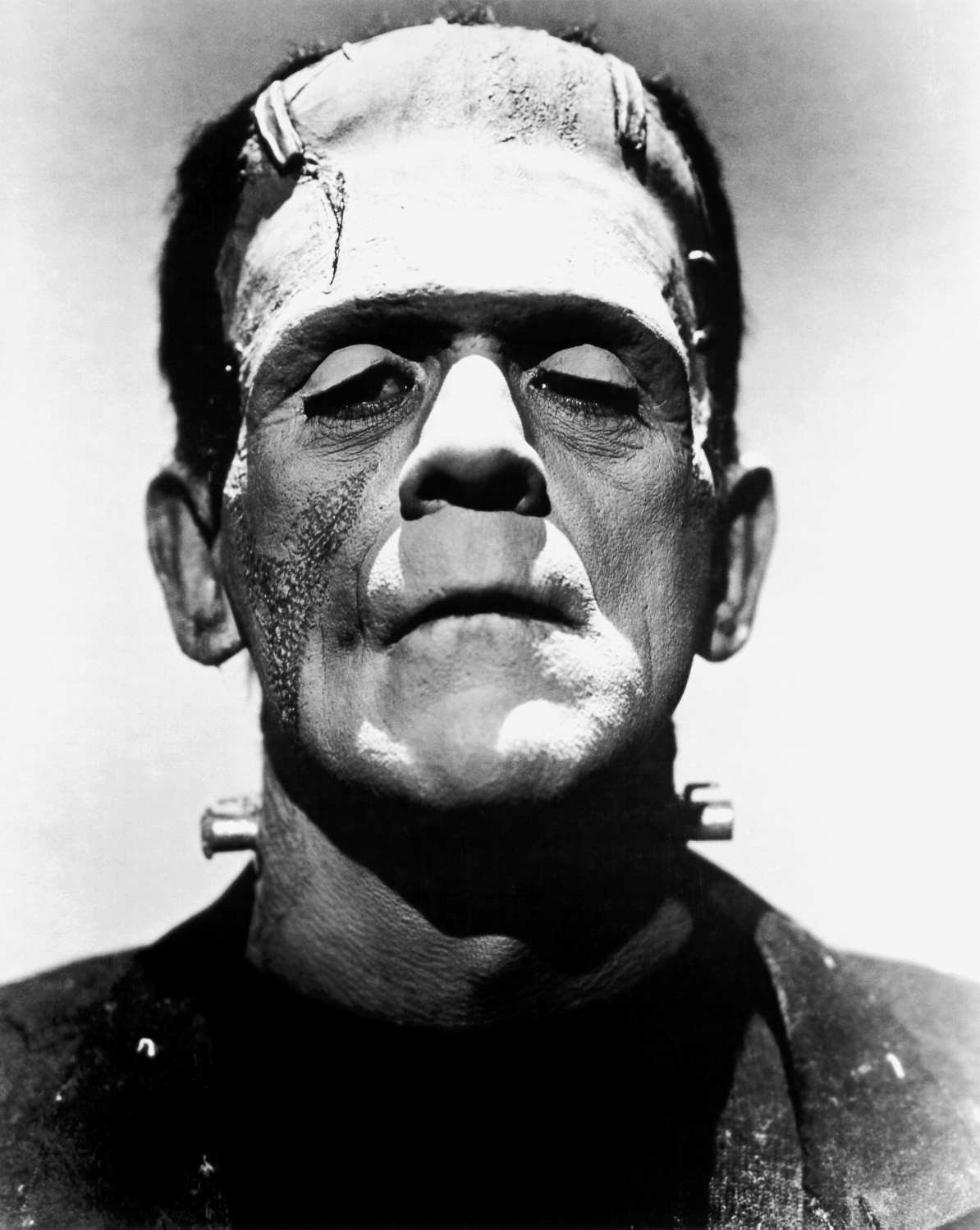
#2

Slide 28
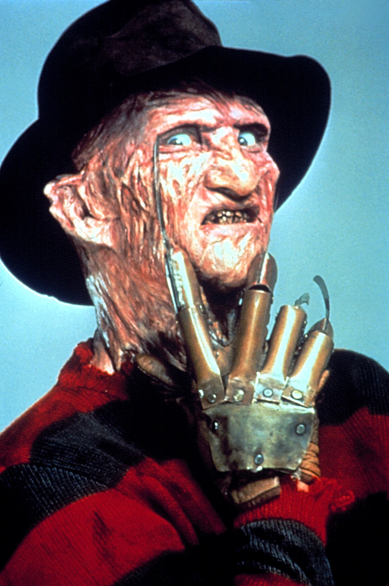
#3

Slide 29
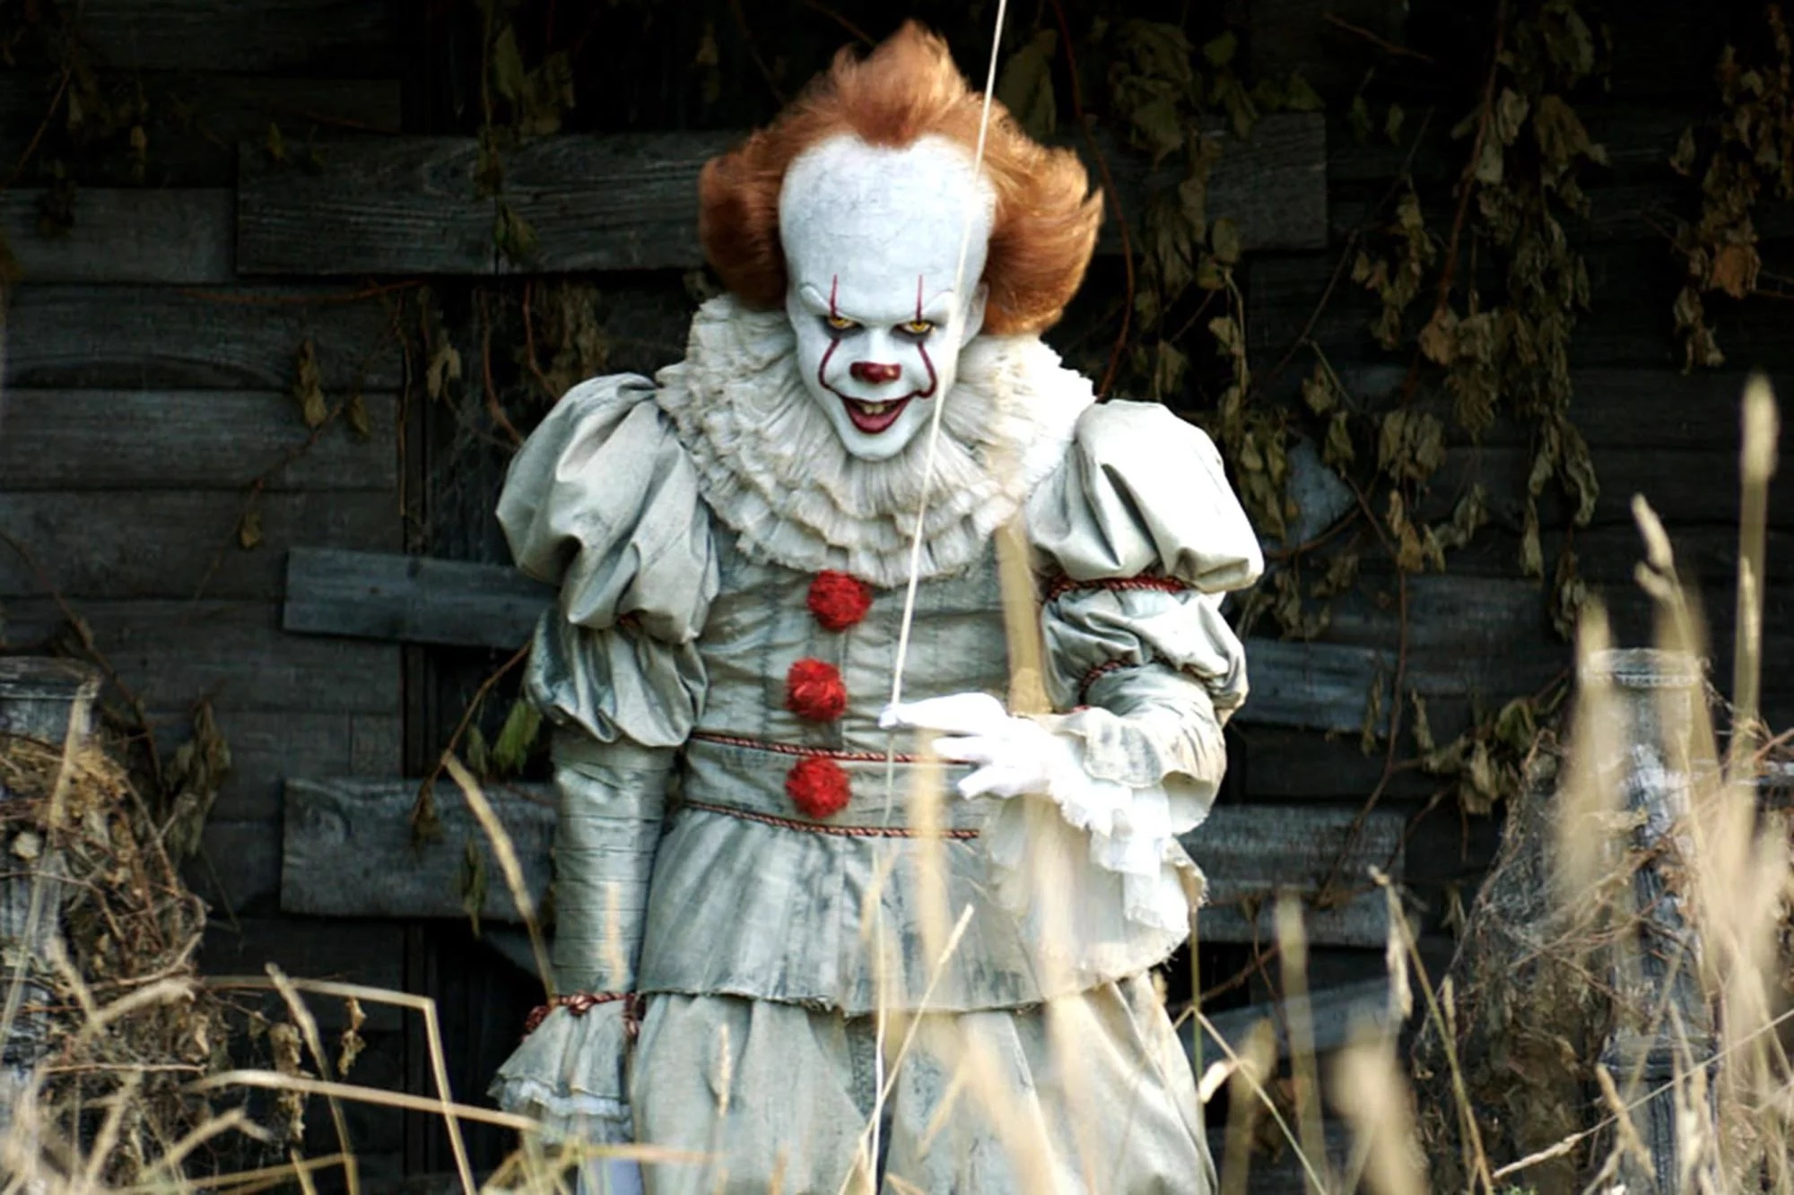
#4

Slide 30
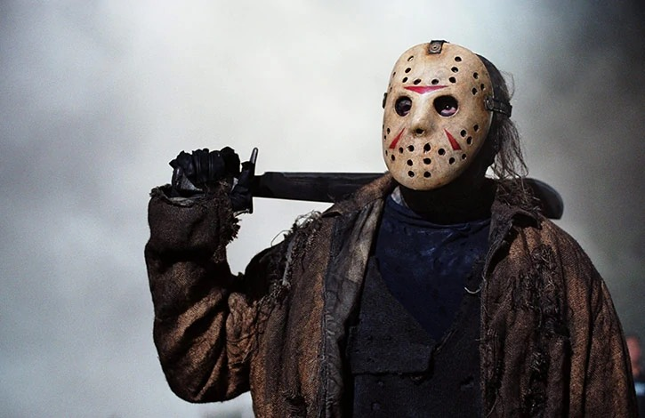
#5

Slide 31
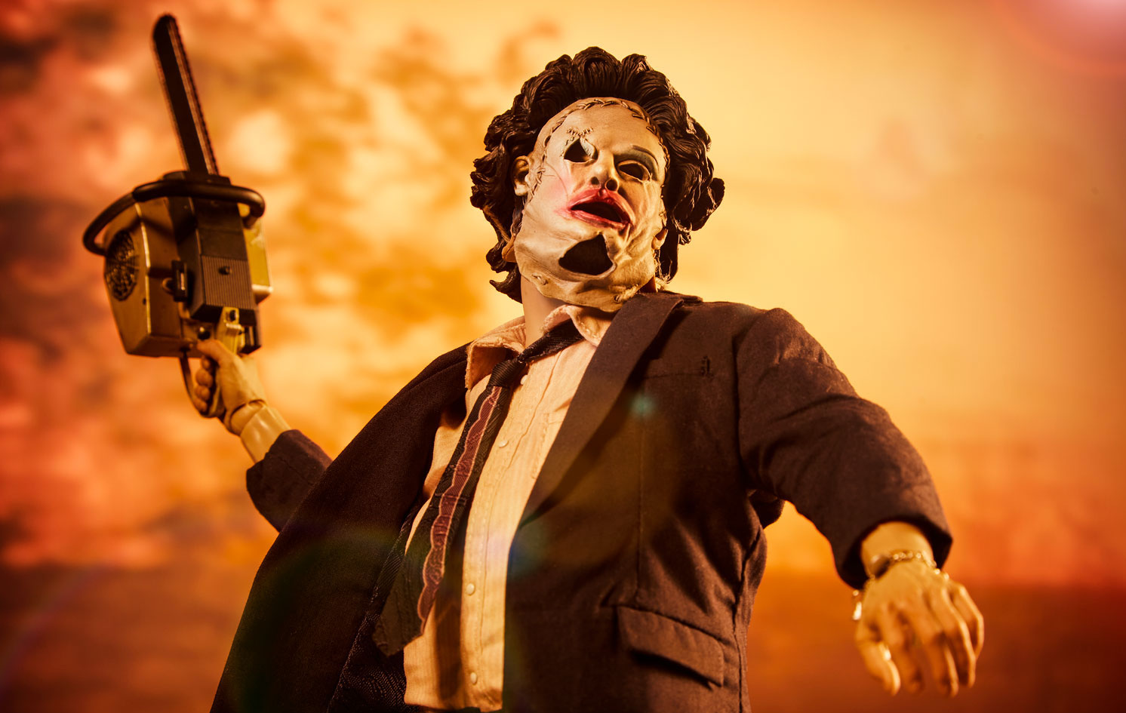
#6

Slide 32
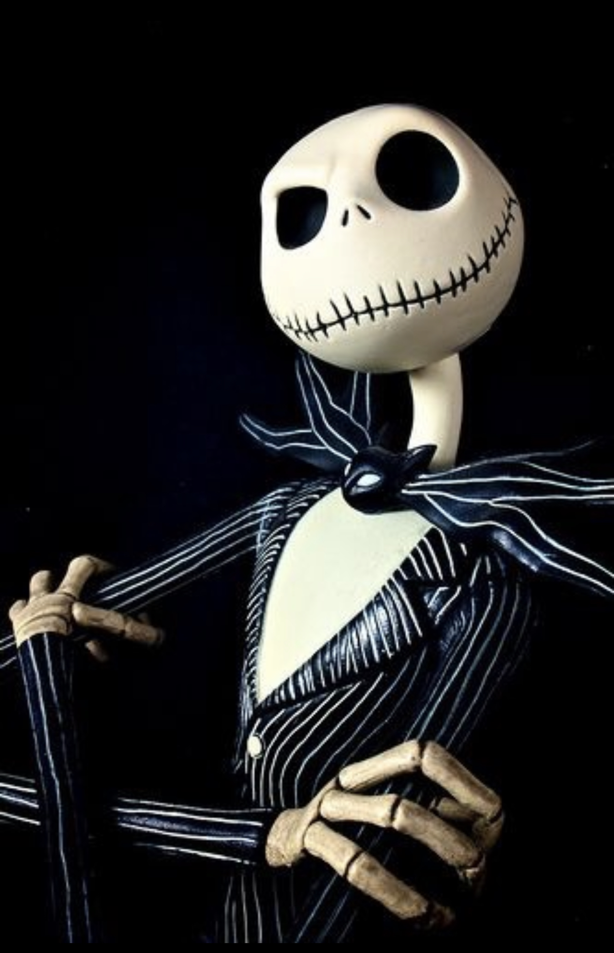
#7

Slide 33
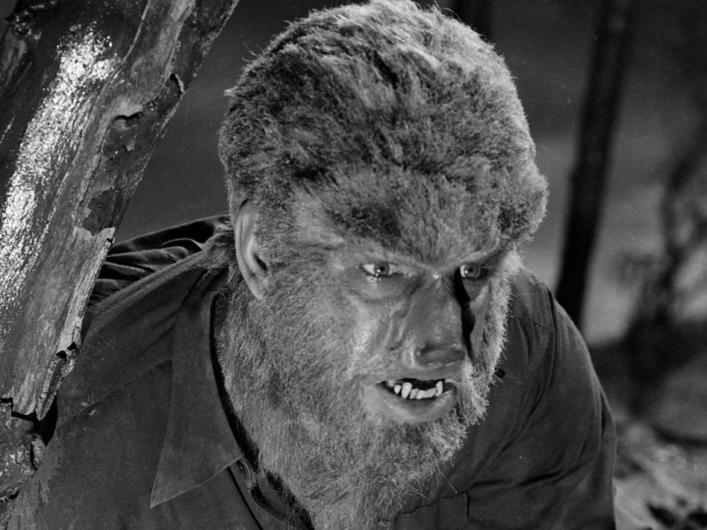
#8

Slide 34
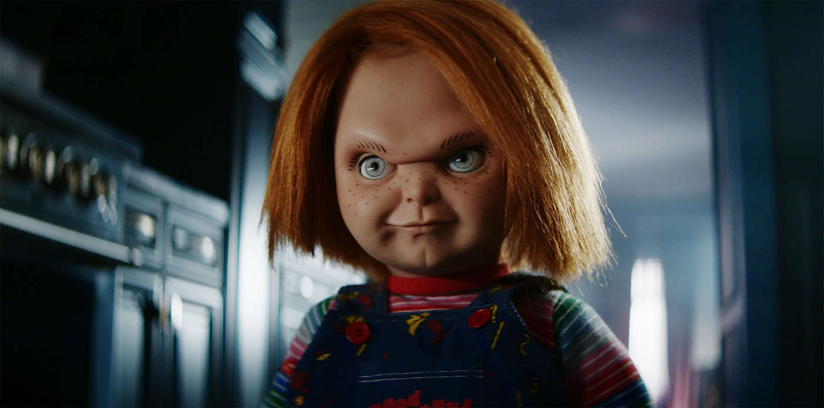
#9

Slide 35
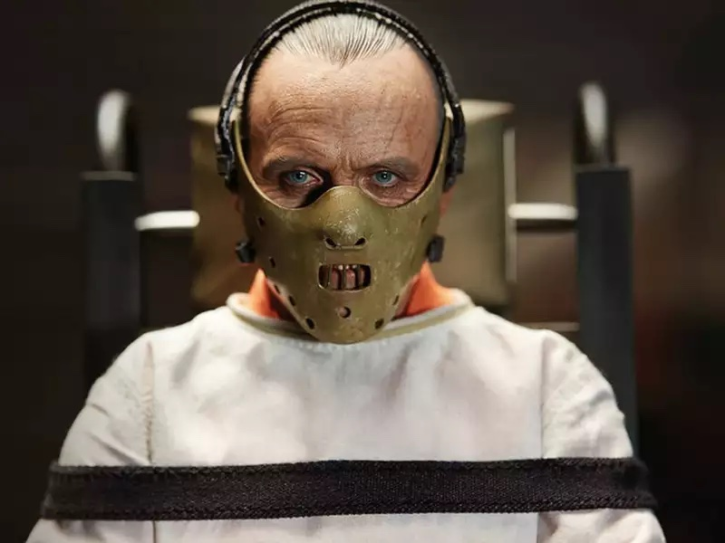
#10

Slide 36
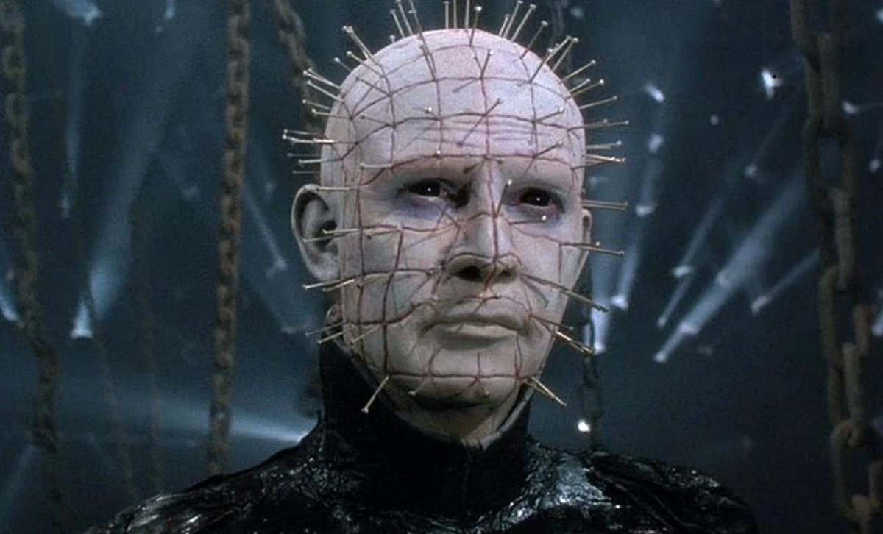
#11

Slide 37
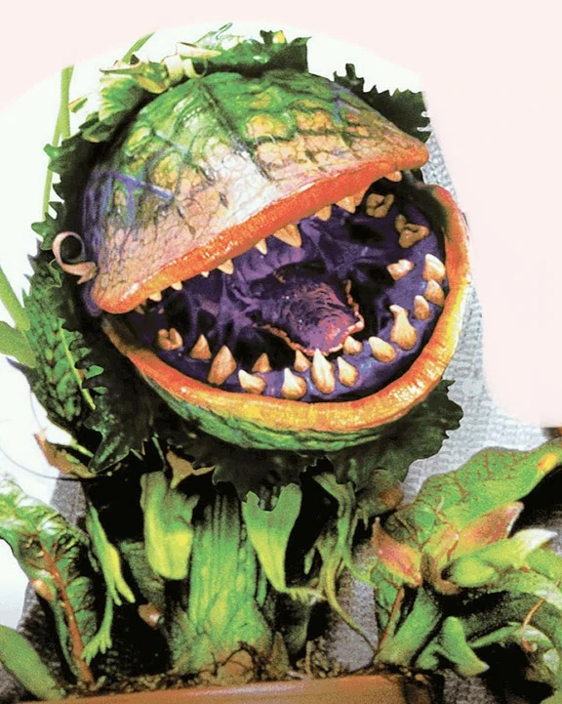
#12

Slide 38
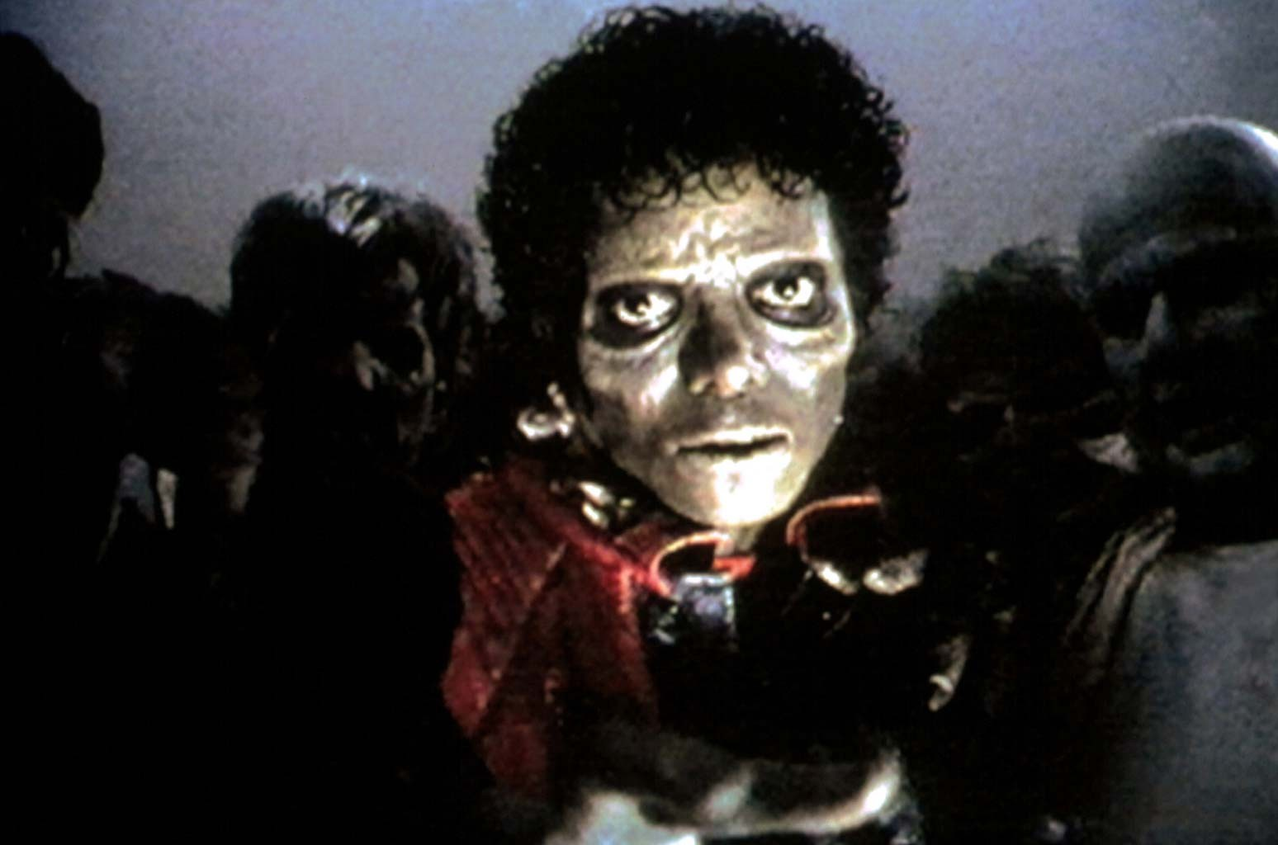
#13

Slide 39
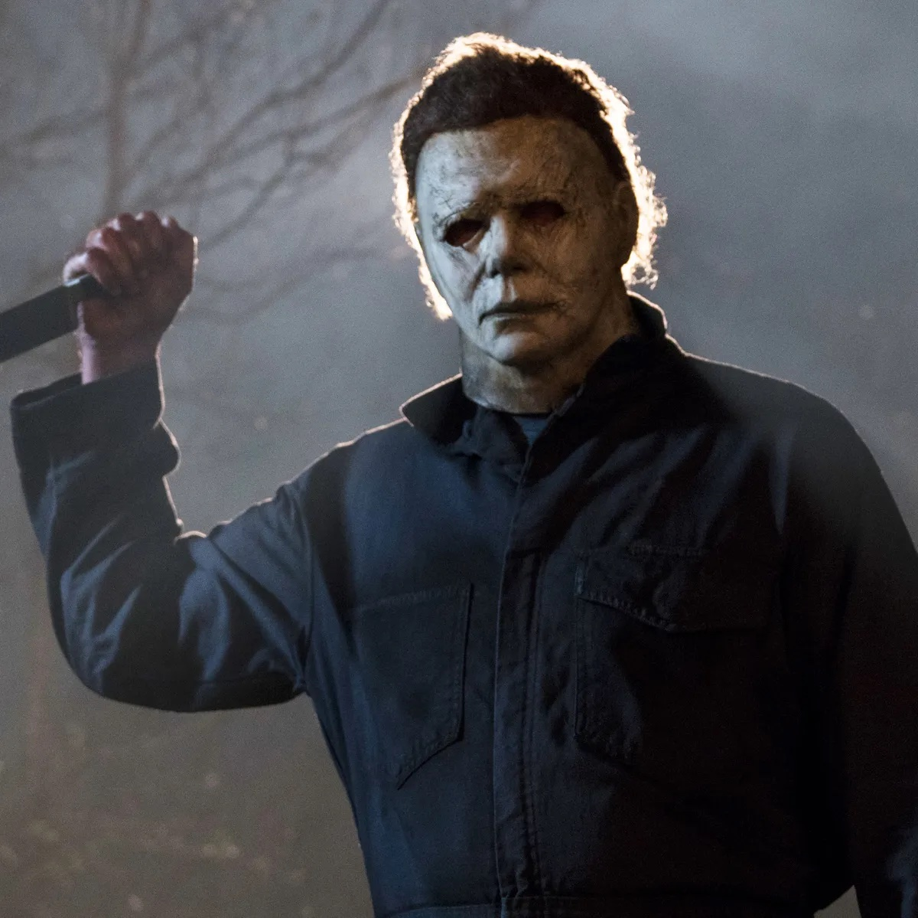
#14

Slide 40
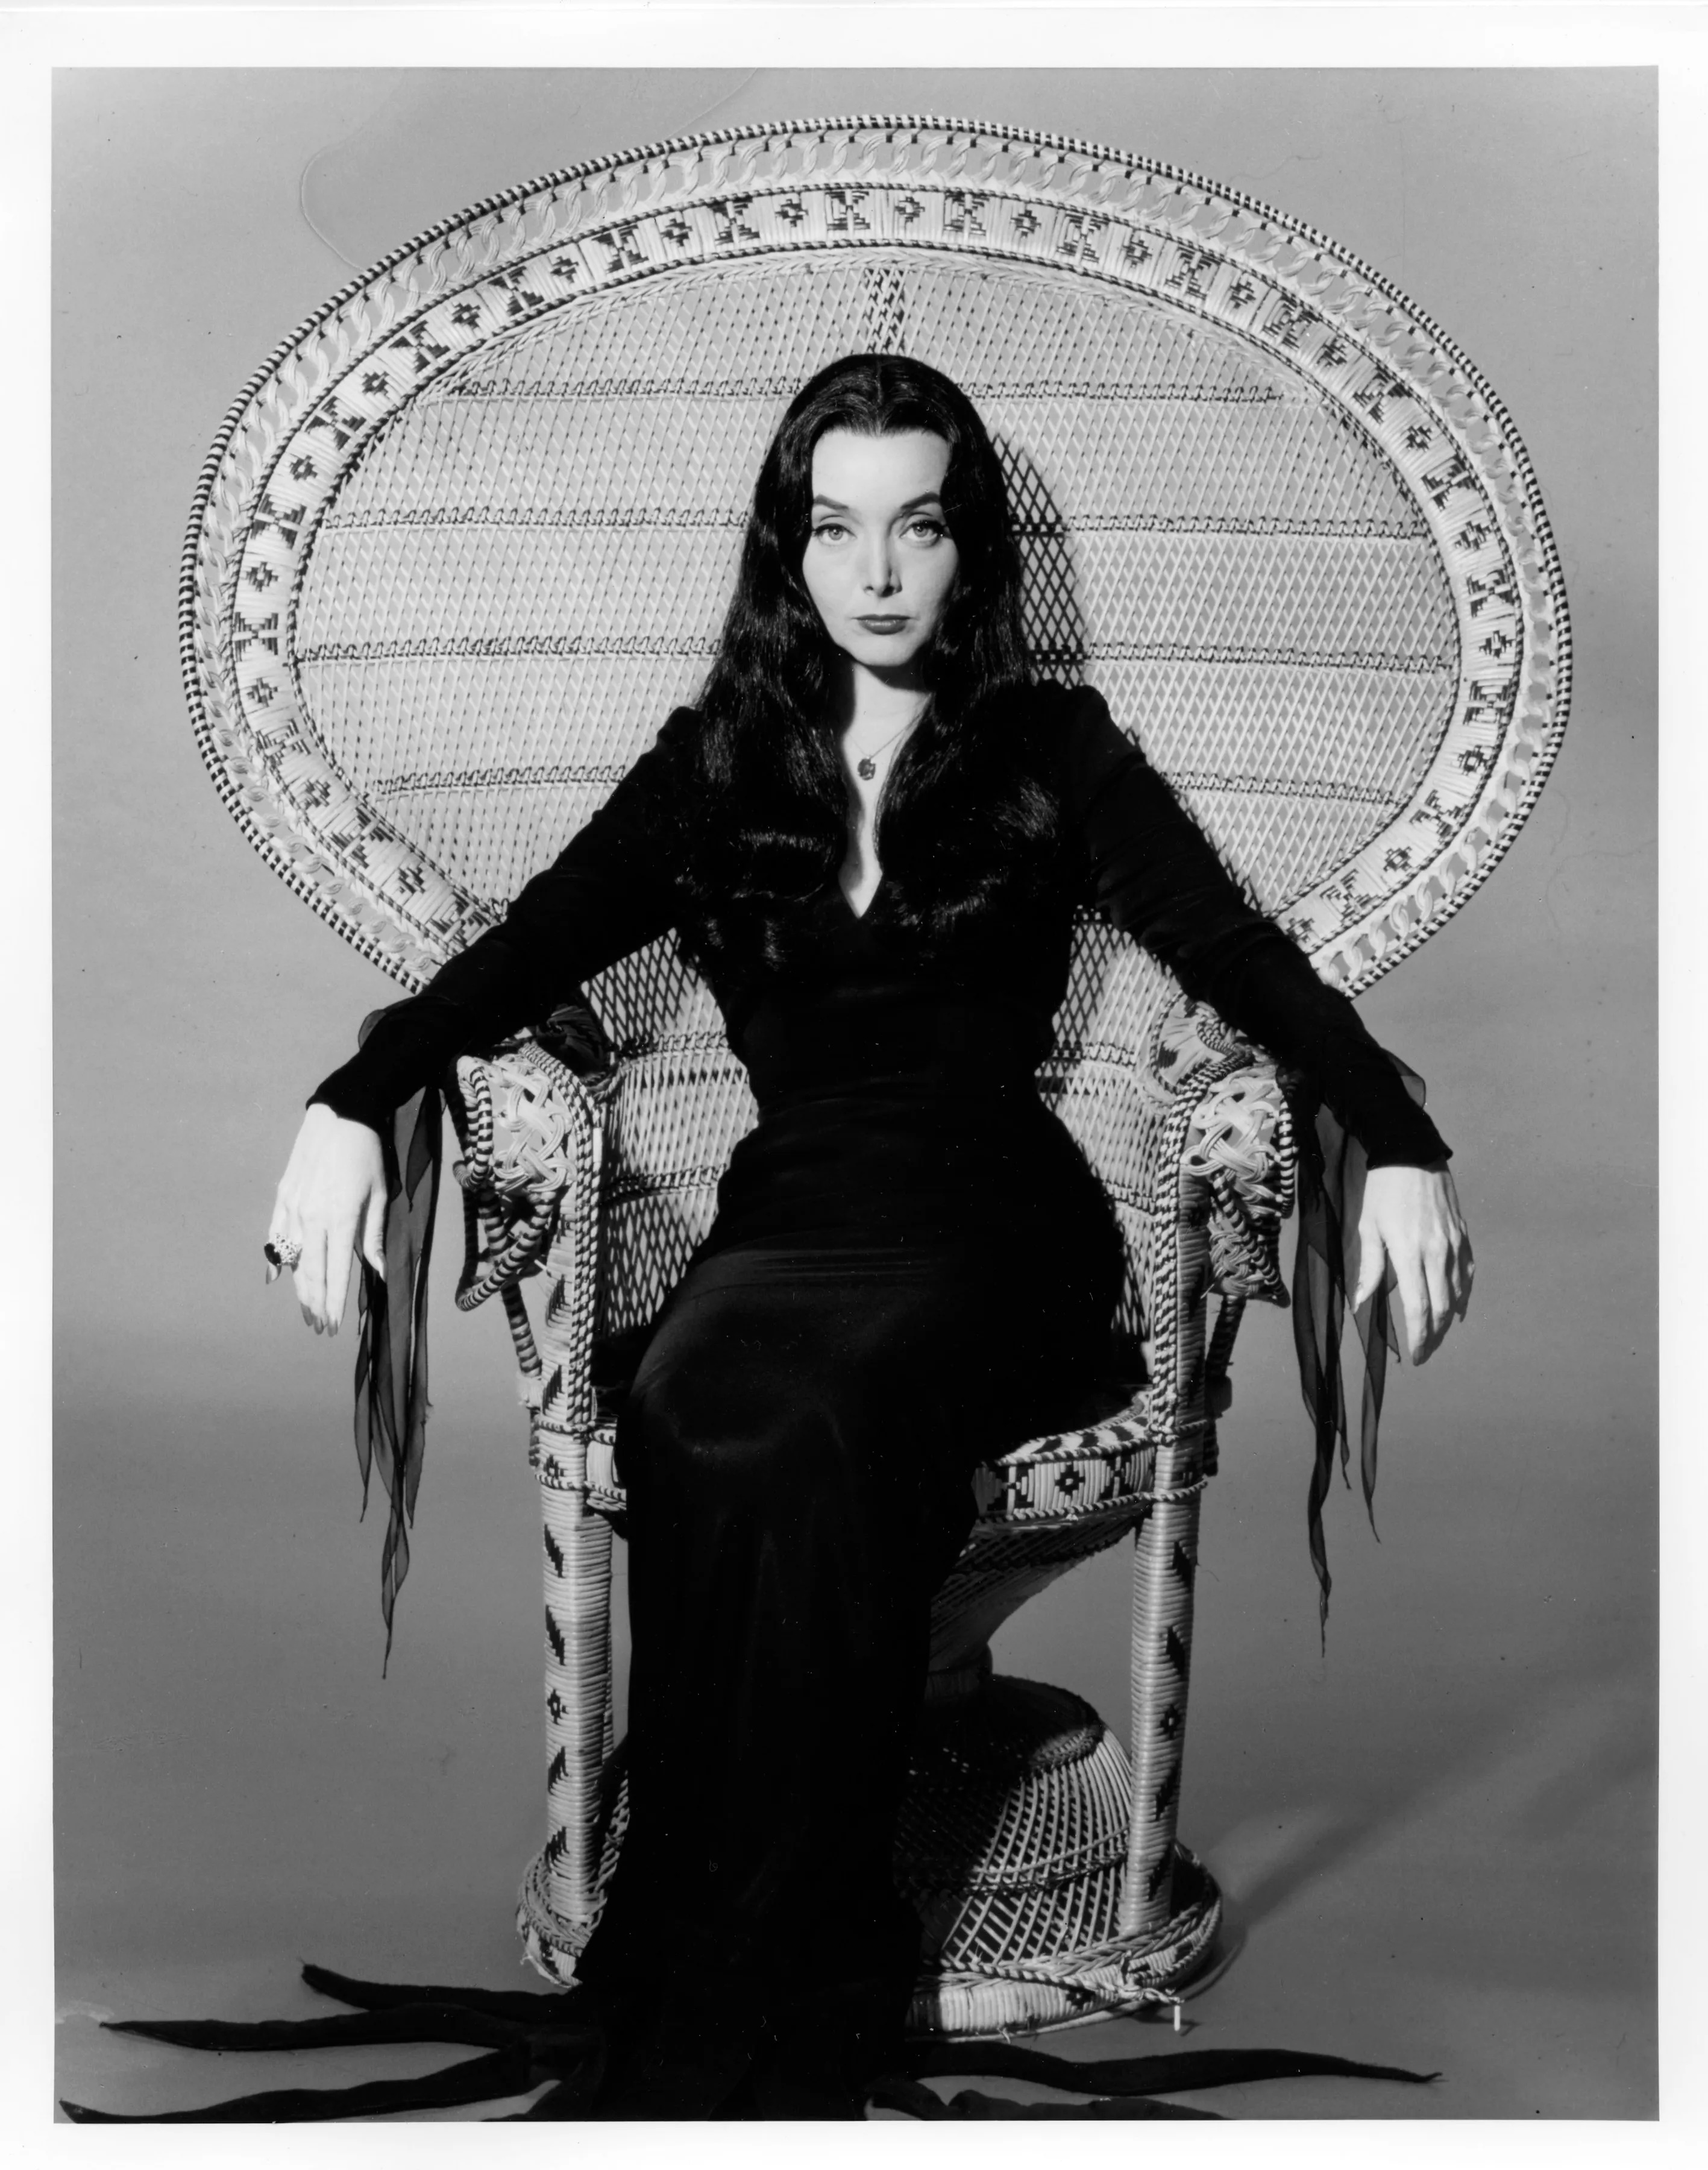
#15

Slide 41
Answers:
1. Dracula - Bella Lugosi
2. Frankenstein - Boris Karloff
3. Freddy Kruger - from the Nightmare on Elm Street Movie Series
4. Pennywise - from the Movie "It" by Stephen King
5. Jason Voorhees - from the Friday the 13th Movie Series
6. Leatherface - from the Texas Chainsaw Massacre
7. Jack Skellington - from Tim Burton's Nightmare Before Christmas
8. Wolfman - Lon Cheney Jr.
9. Chucky the Doll - from the Chucky Movie & Television Series
10. Hannibal Lecter - Anthony Hopkins from Silence of the Lambs, et al
11. Pinhead - Doug Bradley in Hellraiser
12. Audrey 2 - from Little Shop of Horrors
13. Michael Jackson from the Music Video "Thriller"
14. Michael Myers from the "Halloween" Movie Series
15. Morticia Addams - Carolyn Jones, from the TV Series The Addams Family

Slide 42
Rocky Horror Picture Show
A popular movie during the Halloween season is the
Rocky Horror Picture Show. The story centers on a young engaged
couple whose car breaks down in the rain near a castle where
they seek a telephone to call for help. It is a 1975 musical comedy horror film,
that has established a huge cult following over the years due to
audience participation. Audience members talked back to the screen
and began dressing as the characters, and performed alongside the film,
spawning similar performance groups across the United States.
Still in limited release 46 years after its premiere, it is the longest-running
theatrical release in film history. One of the most memorable scenes
in the movie is the Time Warp. The dance that accompanies the
song is the most popular audience-participation activity of all time.

Slide 43


Slide 44
2021 - The Connecticut State Grange

