Slide 1

Marketing
Experimentation:
Thinking Outside
The Traditional Box
CONNECTICUT STATE GRANGE
Virtual Social Hour - November 21, 2024

Slide 2
As a Grange organization, you’re on a mission, but with a tight budget. You have dreams and goals to accomplish and further your causes, but sadly, it all comes with a price tag.
Marketing strategies can be difficult when your first priority goes toward keeping your Grange alive, or maintaining your Grange Hall.
Marketing your Grange offers an invaluable tool in generating awareness, increasing membership, and raising donations. So, what to do? That’s where experimental marketing, or “Thinking Outside The Box” comes in.

Slide 3
What is “Thinking Outside the Box”
in Marketing?
(And how can Granges benefit?)
"Thinking outside the box" in marketing means utilizing creative, unconventional strategies to stand out from others, capture attention, generate buzz, and connect on a deeper level, ultimately leading to more memorable impressions and potentially higher engagement compared to traditional methods. Granges who are willing to try something new and different have opportunities to reach more people, and thus, become more noticed.

Slide 4
Key reasons to
"think outside the box”
Stand out from the crowd:
By using unique marketing tactics, Granges can differentiate themselves from other Granges and other local organizations, making your message more likely to be noticed.

Slide 5
Key reasons to
"think outside the box”
Generate excitement and buzz:
Unconventional marketing for Granges can spark conversation, and with the use of social media, it can increase views and sharing, organically reaching a wider audience.

Slide 6
Key reasons to
"think outside the box”
Emotional connection:
Creative approaches can tap into emotions, fostering a stronger connection with your Grange and its mission.

Slide 7
Key reasons to
"think outside the box”
Cost-effectiveness:
Innovative strategies can be more budget-friendly than traditional advertising methods, maximizing the Grange’s return on marketing investment.

Slide 8
Key reasons to
"think outside the box”
Attract new community segments:
Exploring new marketing avenues can help Granges reach specific groups or “niche audiences” within the community that might be overlooked with standard marketing tactics. For example, the local Veterans group or the local gardening club.

Slide 9
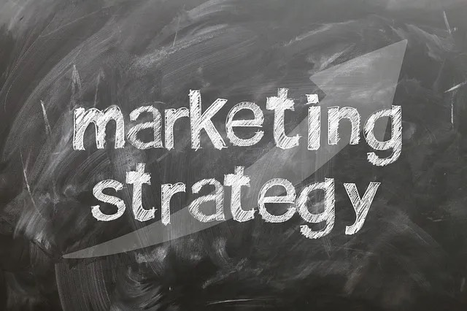

Slide 10
Before trying an “outside the box” marketing method, remember these points, then develop a marketing strategy:
Align with your Grange’s mission: Ensure all creative ideas directly reflect your Grange's core values and goals.
Target your local audience: Understand who you're trying to reach (ie: local organizations, Grange neighbors, students, etc.) and tailor Grange marketing accordingly.

Slide 11
Before trying an “outside the box” marketing method, remember these points:
Storytelling is key: Use compelling narratives to connect with potential members and volunteers on an emotional level. (i.e. community member whose home burned down and how the Grange helped, etc.)
Be authentic: Be honest and genuine in messaging and interactions with your Grange’s audience.

Slide 12
Before trying an “outside the box” marketing method, remember these points:
Measure your impact: Track the results of all Grange marketing campaigns to identify what works and what needs adjustment.
Personalization: Experiment with personalized messaging to deliver relevant content and create a more impactful Grange experience.

Slide 13
Let’s take a look at a few of the numerous types of Experimental Marketing.

Slide 14
Types of Experimental Marketing
Experiential Marketing:
Experiential marketing is the process of creating an experience for a Grange’s audience rather than approaching them through traditional marketing methods.
Experiential marketing should be memorable.
Creating a fun and unique experience is one of the best ways to connect with people to ensure they want to learn more about the Grange and what it offers.

Slide 15
Types of Experimental Marketing
Experiential Marketing Ideas:
Sensory experiences: Host a "blind taste test" to raise awareness about food insecurity, or a "silent room" to highlight the challenges of hearing loss.
Interactive installations: Create a temporary art installation that directly relates to your Grange, allowing people to interact with it and learn about your mission.
Community challenges: Organize a "walk a mile in their shoes" event where participants experience a day in the life of someone facing the local issues your Grange addresses.

Slide 16
Types of Experimental Marketing
Fundraising Innovations:
Are Granges making the most of the latest trends in fundraising?
First, there was fundraising by direct mail. Then, there was fundraising by website. Now, there’s a third shift in fundraising — social fundraising.
Social fundraising refers to fundraising campaigns on social media networks. Currently, three social networks have built-in fundraising capabilities: TikTok, Facebook, and Instagram, the latter two owned by parent company Meta.

Slide 17
Types of Experimental Marketing
Fundraising Innovations Ideas:
Donation-based games: Develop a simple online game where users can "donate" virtual currency to progress through levels, with real-world donations tied to gameplay.
Skill-based volunteering: Allow people to donate their professional skills to your Grange, like graphic design or marketing expertise, instead of a donation. Use Social Media as a means to solicit help by listing the services your Grange needs.
"Pay it forward" campaign: Partner with a local business then encourage customers to add a small donation to their bill to support your Grange.

Slide 18
Types of Experimental Marketing
Social Media Campaigns:
A "social media campaign" in marketing refers to a coordinated effort to use one or more social media platforms to promote a brand, product, or service, aiming to achieve a specific marketing goal through strategic content, engagement tactics, and tracking of results over a set period of time; essentially, it's a planned series of posts and interactions designed to influence audience perception and behavior on social media platforms.

Slide 19
Types of Experimental Marketing
Social Media Campaigns:
Purpose: To increase Grange awareness, drive traffic, generate membership leads, boost donations, or foster community engagement.
There are five stages for social media campaigns: Awareness, Interest, Engagement, Action, and Advocacy. Social platforms provide more opportunities for interaction.

Slide 20
Types of Experimental Marketing
Social Media Campaign Ideas:
Hashtag challenges: Encourage users to share photos or videos doing a specific action related to your Grange’s cause, using a dedicated hashtag. (i.e.: #GrangeStrong)
Live Q&A: Host an Instagram or Facebook live where people can ask questions directly of officers about Grange activities, events and mission.
Social media "takeover": Partner with an influencer to take over your Grange social media for a day, sharing their perspectives.

Slide 21
Types of Experimental Marketing
Community Partnerships:
Community partnerships refer to a strategy where organizations collaborate with local businesses, to promote their mission by aligning with causes and values that resonate, ultimately building a positive image and increasing loyalty through meaningful community engagement; this can involve sponsoring events, volunteering time, or donating products to support local initiatives.

Slide 22
Types of Experimental Marketing
Community Partnership Ideas:
Local artist collaborations: Partner with local artists to create artwork that reflects your Grange mission, then host a display, or art show where the pieces will be sold as a Grange fundraiser.
Cross-promotions with businesses: Collaborate with businesses to offer discounts or special promotions as a fundraiser. (i.e. Jimmy’s Store Grinder Sales)
Cause-related marketing: Partner with a local brand to develop a product line where a portion of the proceeds go directly to your Grange.

Slide 23
Types of Experimental Marketing
Event-Based Marketing:
Event-Based Marketing is a strategy that creates and hosts events to promote Granges. This type of marketing is also known as triggered marketing or event-initiated marketing.
EBM works by identifying key opportunities in the community, or local behavioral patterns, and creating relevant events. These events can include:, trade shows, meet-ups, workshops, conferences, webinars, and even open houses and milestone celebrations.

Slide 24
Types of Experimental Marketing
Event-Based Marketing Ideas:
Themed events: Host a unique themed event, like a "mystery dinner" where guests learn about your Grange through the storyline of the evening.
Virtual events: Leverage online platforms to host webinars, online auctions, or even virtual concerts and talent shows, making your Grange accessible to a wider audience.
"Give back" experiences: Organize events where participants can directly engage with the people your Grange serves, like a volunteer day at a local animal shelter.

Slide 25
Types of Experimental Marketing
Sonic Branding/Marketing:
How many brands do you recognize simply from a tune or melody that is played? When you think about it, there are probably a lot more than you realize. That’s why sonic branding is so important. It helps customers recognize a brand by just hearing the brand’s jingle, melody, or tune.

Slide 26
Types of Experimental Marketing
Sonic Branding/Marketing Ideas:
Spotify Playlists: Create a Spotify Playlist for your Grange. Rotate through each officer and committee so it changes each month. Then promote it to gain listeners.
Ringtones: Create a custom ringtone for your Grange, then distribute through your website or social media. This can be accomplished through musical instruments, songs, or sound effects.
Produce a Grange Jingle: Host a jingle writing contest, then produce a video advertisement for your Grange using the winner. Place the video on YouTube, Facebook, Instagram, etc.

Slide 27
Types of Experimental Marketing
“Selling the Sizzle” Marketing:
Have you heard the saying ‘sell the sizzle not the sausage!’? "Selling the Sizzle" means focusing on the emotional benefits of promotion. It emphasizes creating a connection with the audience by highlighting how the product, service, event, etc. can enhance their life, provide solutions to their problems, or make them feel a certain way.
The term was first used by Elmer Wheeler in the 1930s. Wheeler was skilled at persuading people. He came up with the phrase, “Don’t sell the steak, sell the sizzle,” meaning, focus on the exciting and emotional aspects of a product, not just its basic features. This idea changed the way people thought about selling and advertising.

Slide 28
Types of Experimental Marketing
“Selling the Sizzle” Marketing:
Create a compelling story: Focus on the positive transformations the Grange can bring to peoples lives. It's not about the Grange itself but the enhanced lifestyle it offers.
Showcase value: Be genuine. It isn’t about exaggeration or false promises. It’s about showcasing the true value of the Grange in a compelling manner. Ensure that the experiences and benefits are real and attainable.
Example: Instead of focusing on the intricate mechanics of a luxury watch, advertise the feeling of confidence and success associated with wearing a high-end timepiece.

Slide 29
Types of Experimental Marketing
“Selling the Sizzle” Marketing Ideas:
Create a Grange benefits membership brochure: Illustrate the benefits of Grange membership in a mailable brochure. Keep the marketing copy friendly. Use fun and engaging photos.
Solve a Community Issue, then promote it: What is your Grange community missing? Find out, then implement a plan to fix it. The goal is to have the community brag about the Grange to everyone they know.

Slide 30


Slide 31
Types of Experimental Marketing
Guerrilla Marketing:
The term "Guerrilla marketing" was popularized by Jay Conrad Levinson's 1984 book by the same name.
Guerrilla Marketing uses low-cost, unconventional and surprising tactics to grab attention, often in public spaces. These are unique, immersive experiences that generate buzz, engage audiences and encourage organizations spread. Creativity is a must for Guerrilla Marketing to be successful.
Guerilla Marketing is the most popular type of “Thinking Outside The Box” strategies.

Slide 32
Types of Experimental Marketing
Guerrilla Marketing Ideas:
Door to Door: One-on-one marketing has remarkable effects, which is why door-to-door will never go out of style. Set up a date and plan for volunteers to go into the neighborhood and talk about the Grange. Keep the talks fun, lighthearted and mission-focused, but brief. You don’t want to overwhelm any potential members with a prewritten speech or drawn-out explanation.
Interactive street art: Create a temporary art installation by collaborating with a local artist that engage passersby, like a sidewalk chalk mural of the Grange emblem, or displaying a QR code (like in a laundry mat or grocery store) which is embedded in a drawing, that leads to more information about your Grange.
Pop-up events: Set up a temporary booth in a unique location, like a busy flea market, or host a bake sale at the local market, to educate people about your mission and raise some money too.

Slide 33
Experimental
Marketing
Examples

Slide 34
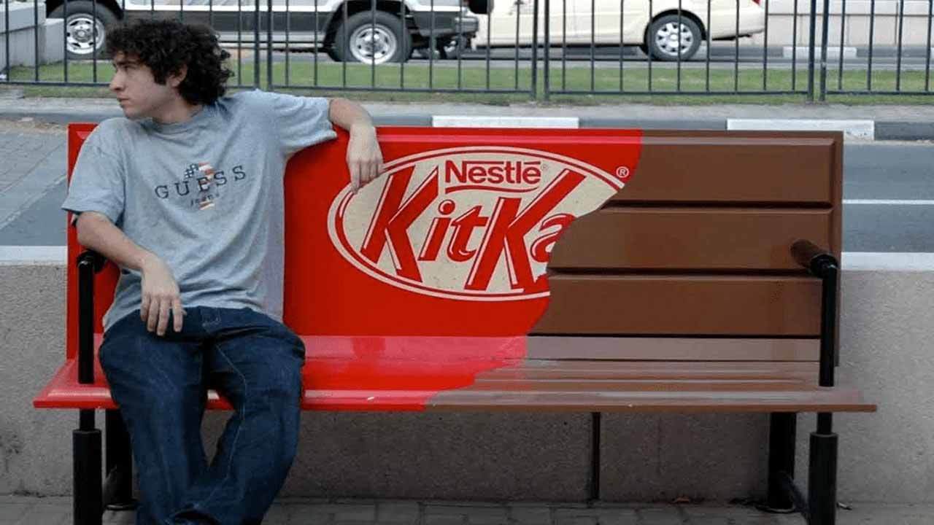
Nestlé - Kit Kat using a park bench for advertising.

Slide 35
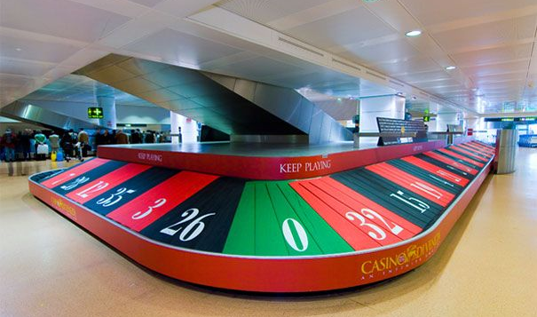
Casino di Venezia - luggage return turned into a giant roulette wheel at Venice Marco Polo Airport in Italy.

Slide 36

IKEA sign in the snow

Slide 37

“Man of Steel” movie utilizing the opening and closing of elevator doors for a promotional opportunity. (2013)

Slide 38
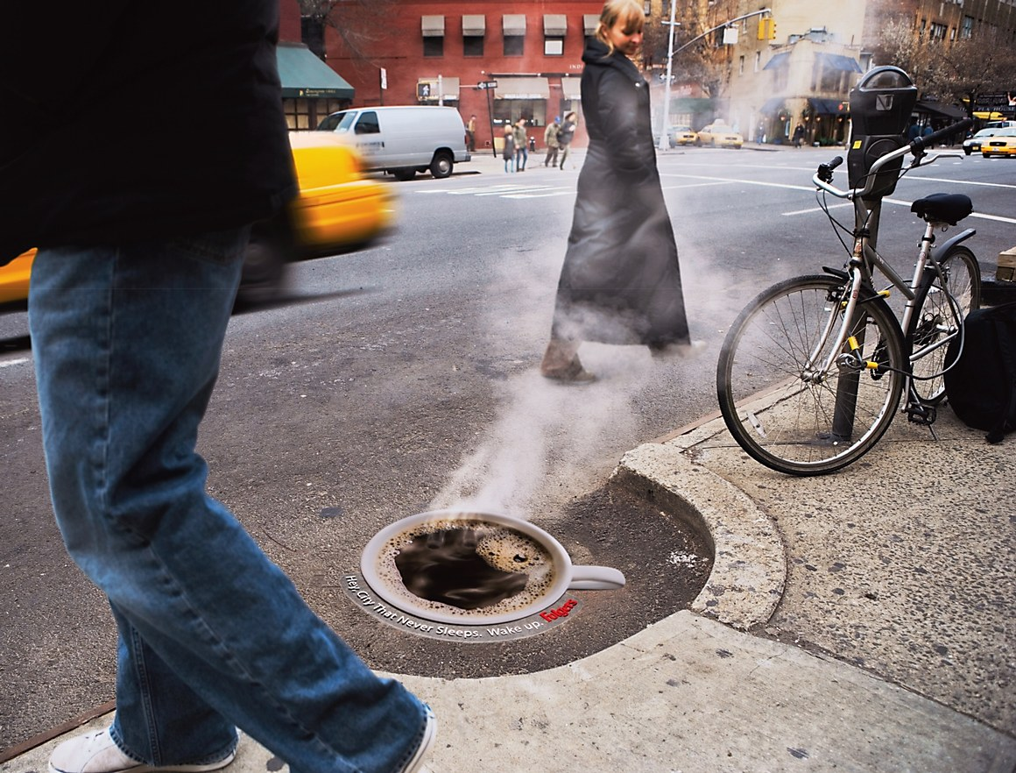
Folgers using a coffee cup decal over a steaming manhole to promote their coffee in New York City.

Slide 39
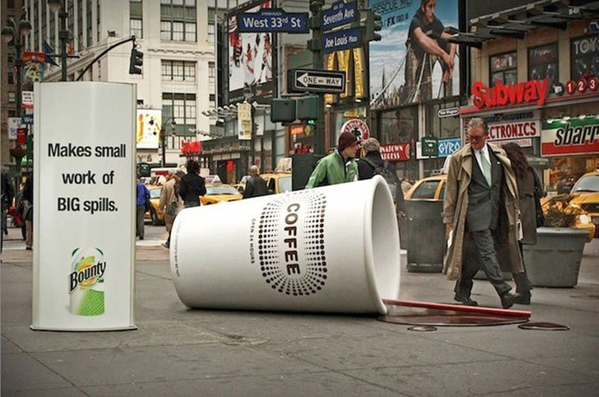
A giant coffee cup and spill catches attention of passersby in NYC for a Bounty promotion.

Slide 40
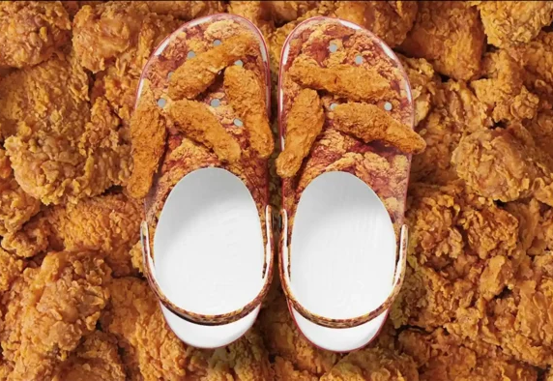
Kentucky Fried Chicken and Crocs Collaborate. (The chicken on top are Jibbitz Charms)
https://www.crocs.com/KFC.html

Slide 41

Mr. Clean spotlighting the bright white strip on a crosswalk.

Slide 42

McDonalds turned a crosswalk into French Fries.

Slide 43
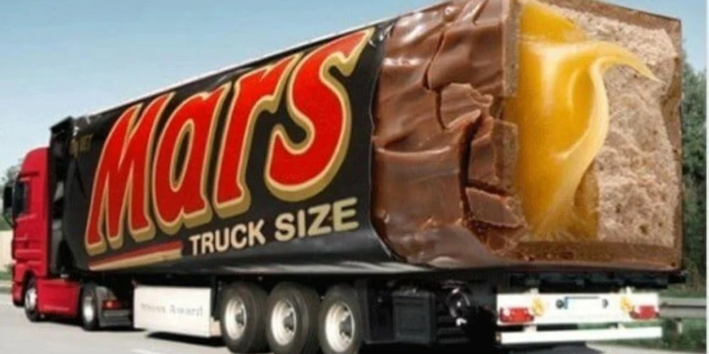
MARS vinyl wrapped an 18-wheeler truck to look like one of their Candy Bars.

Slide 44
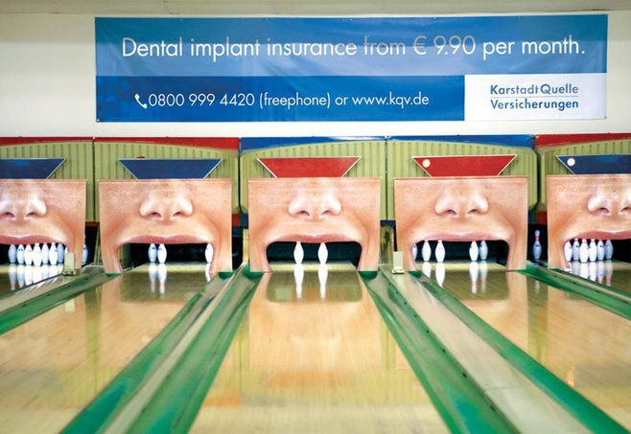
Dental Insurance uses a bowling alley to simulate teeth.

Slide 45
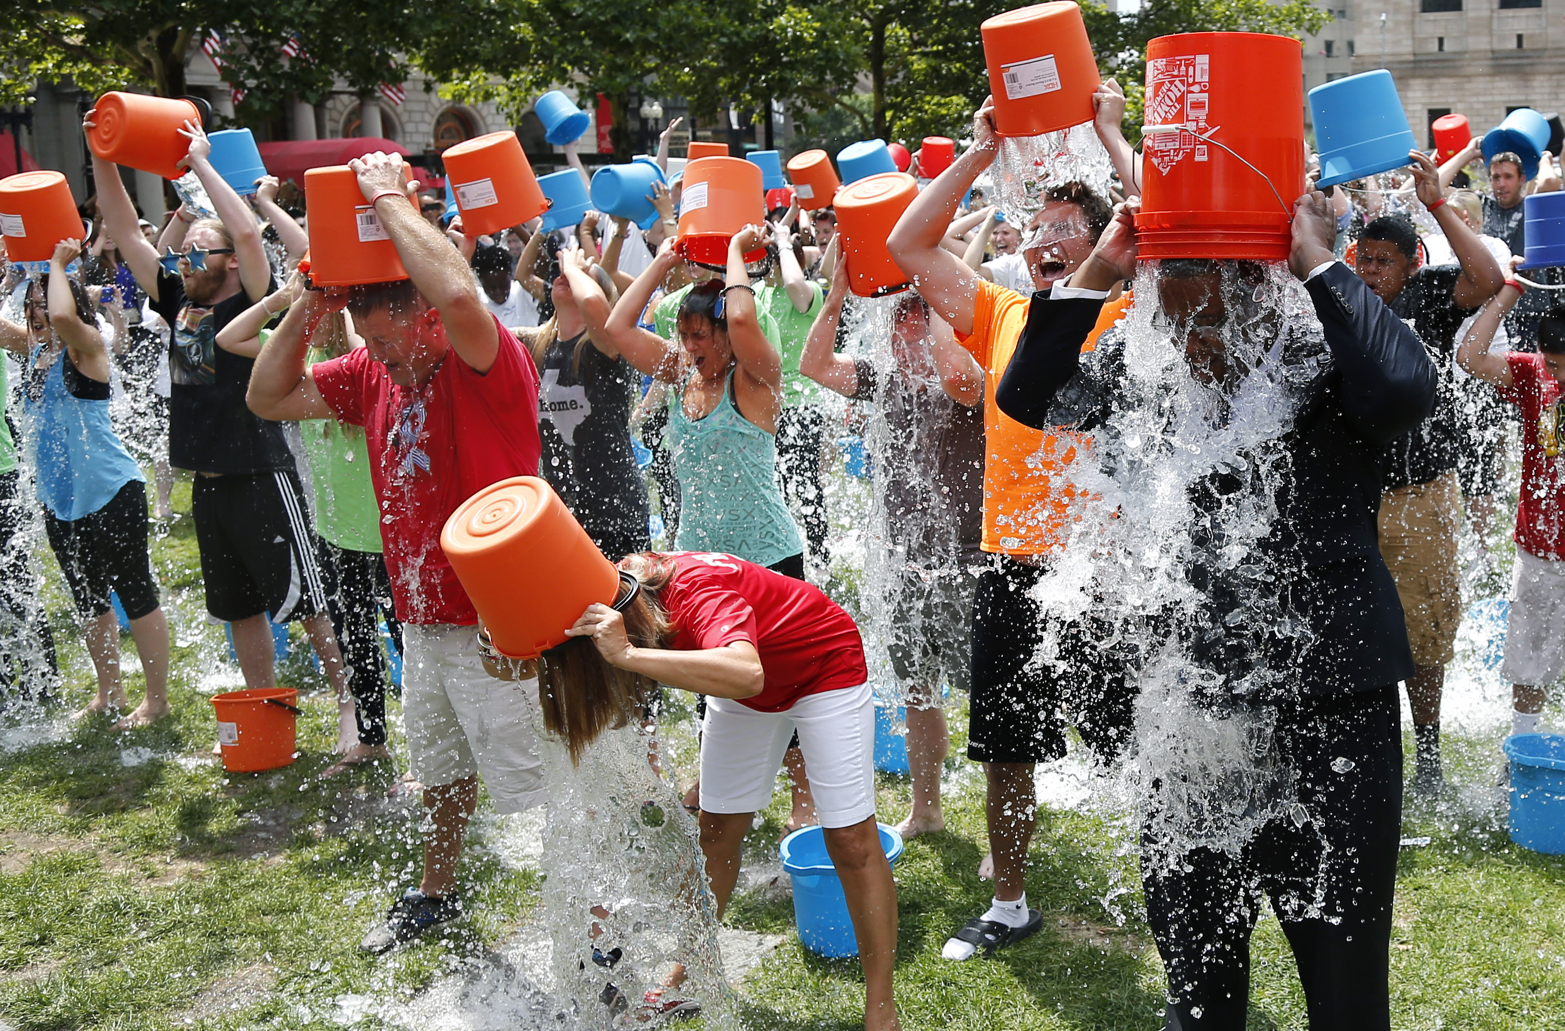
The ALS Ice Bucket Challenge Campaign of 2014

Slide 46
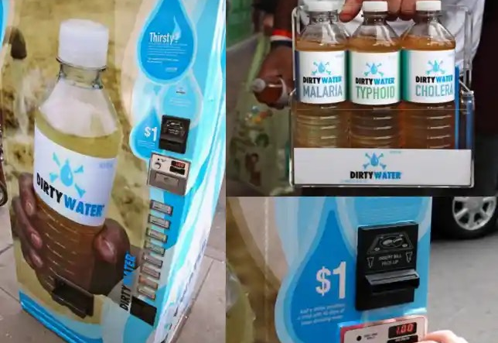
UNICEF (United Nations Children’s Fund) turned“normal” vending machines to something very different in 2009. Malaria, cholera, typhoid, dengue, hepatitis, dysentery, salmonella, and yellow fever—these eight dirty and dangerous water “flavors” were sold by UNICEF through a vending machine in New York City.

Slide 47
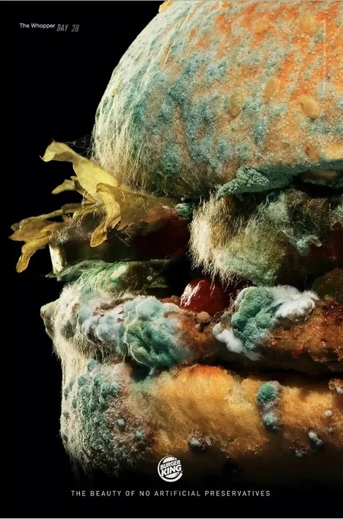
Burger King created a Moldy Whopper ad to promote that their burgers have no artificial preservatives.

Slide 48
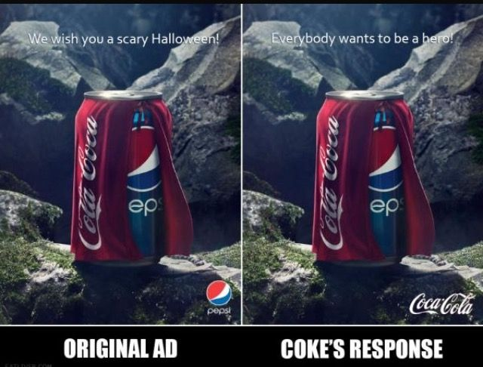
Pepsi created a Halloween ad where their can wore a Coca Cola cape. Coke responded by making their own version of the ad…

Slide 49
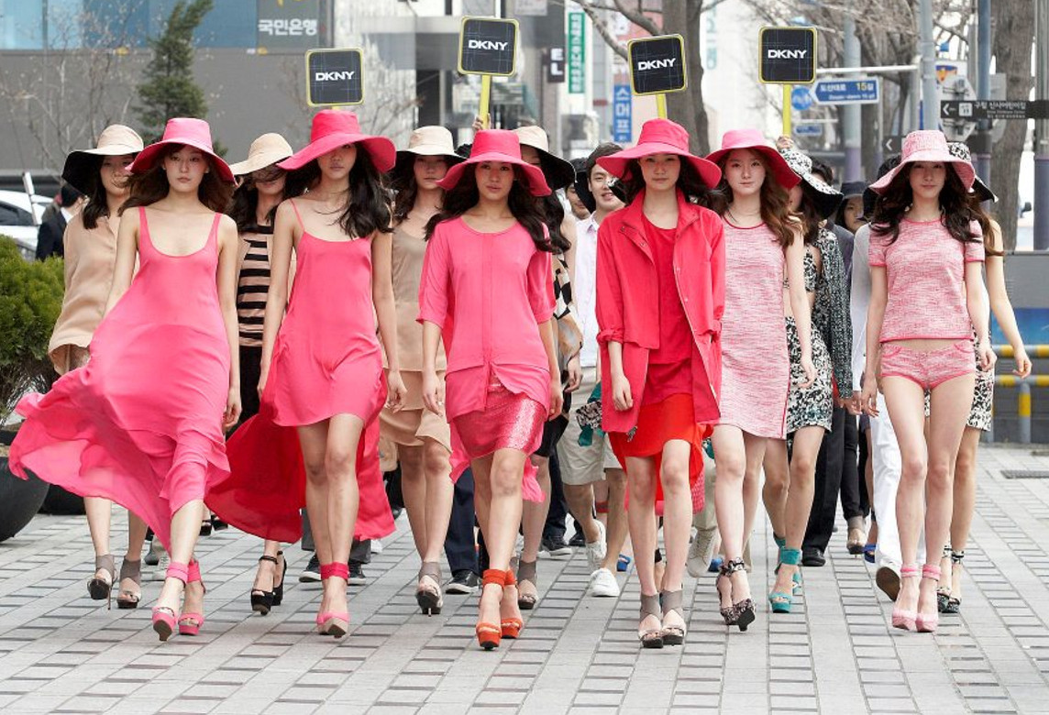
DKNY turned a street in Korea into a runway.

Slide 50
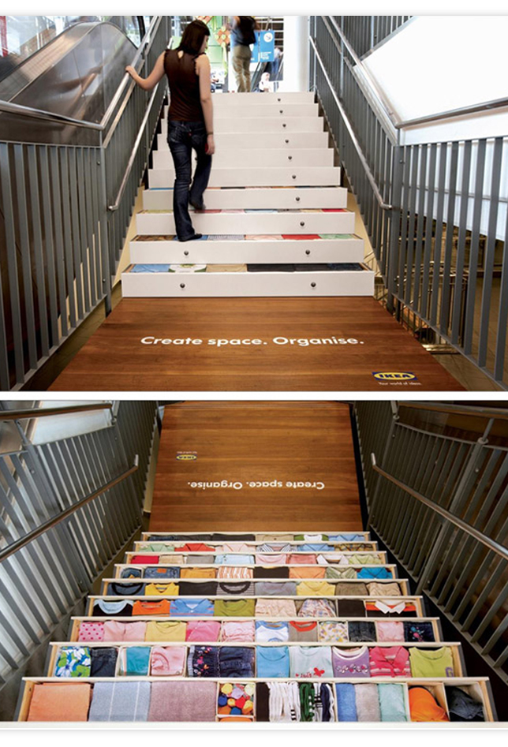
IKEA turned a staircase into filled dresser drawers.

Slide 51
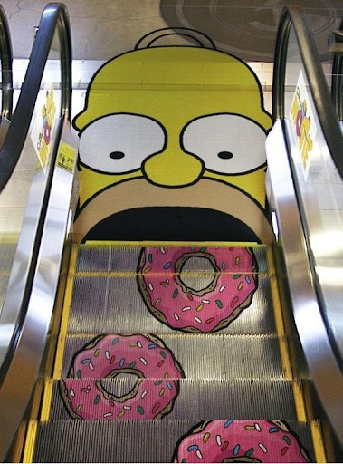
The Simpsons TV Show turned an escalator into a promotional opportunity.

Slide 52
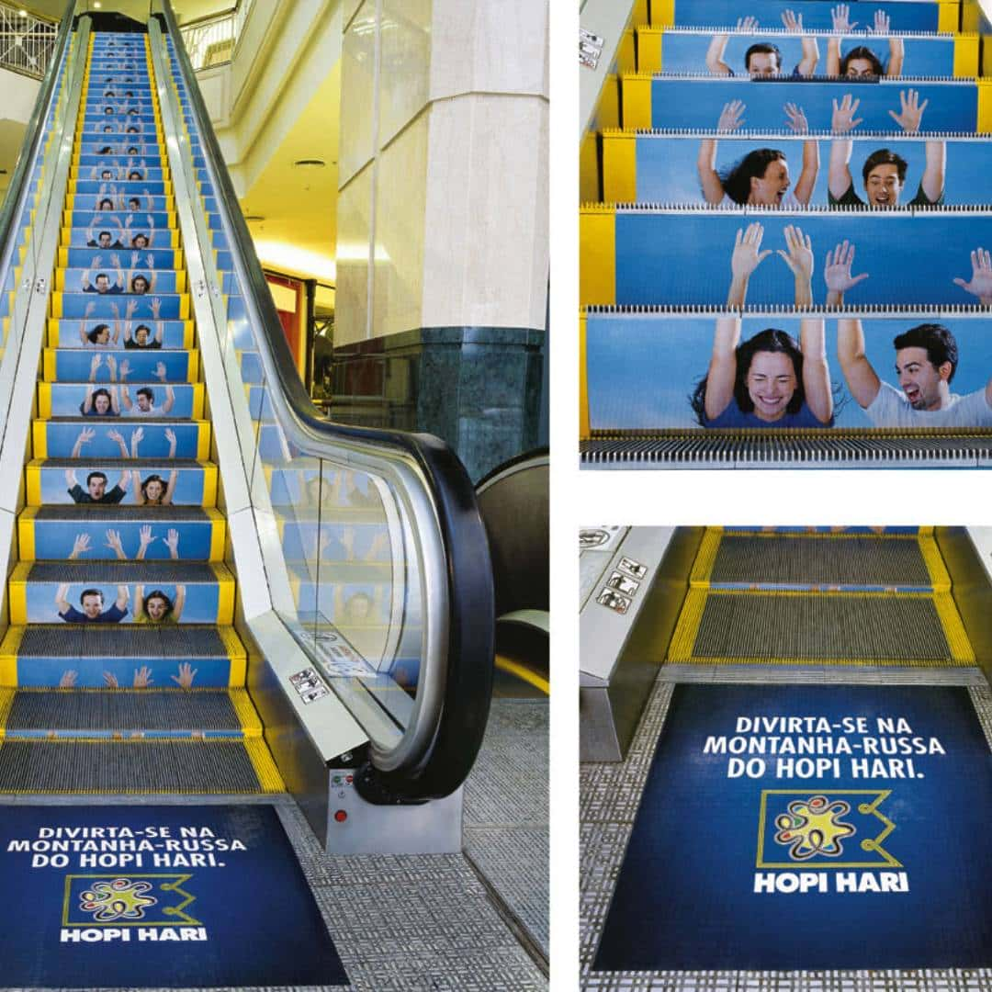
A Brazilian Amusement Park turned an escalator into a rollercoaster.

Slide 53
Final Thoughts…
By utilizing these “thinking outside the box” marketing strategies, Granges can create memorable experiences that go beyond traditional marketing, effectively engaging members, the community and also fostering loyalty.
A successful Grange marketing strategy will not only help members know how they personally feel about the Grange but can also help the community remember the Grange for years to come.

Slide 54

When thinking of implementing experimental marketing techniques, always remember these 4 basic tips:

Slide 55
©2024 Connecticut State Grange

